Slide 1


Unit – 2
Vector Space
B.Tech. $→$1st Semester
Mathematics – I (2601HS101)
Course Outcome:
At the end of this unit, students will be able to explain the concepts of vector spaces, subspaces, linear dependence, basis, and dimension with examples.

Slide 2

Topics of Unit 2
  Real Vector Spaces
  Subspaces
  Linear Combination and Span
  Linear Dependence and Independence
  Basis and Dimension
  Row Space, Column Space, and Null Space
Looping

Slide 3

Outlines of Unit 2
  Vector Space
  Subspaces
  Linear Combination and Span
  Linear Dependence and Independence
  Basis and Dimension
  Row Space, Column Space, and Null Space
Looping

Slide 4
Introduction

Slide 5
Introduction
A vector space is a collection of objects called vectors together with two operations Vector Addition and Scalar Multiplication. These operations satisfy certain mathematical rules.
Vector space is one of the most important concept in linear algebra and is widely used in
  Engineering
  Computer Graphics
  Physics
Vectors may be represented as numbers, ordered pairs, triplets, matrices, polynomials, or functions.
  Machine Learning
  Data Science
  Communication System
  Artificial Intelligence
  Navigation System, etc.

Slide 6
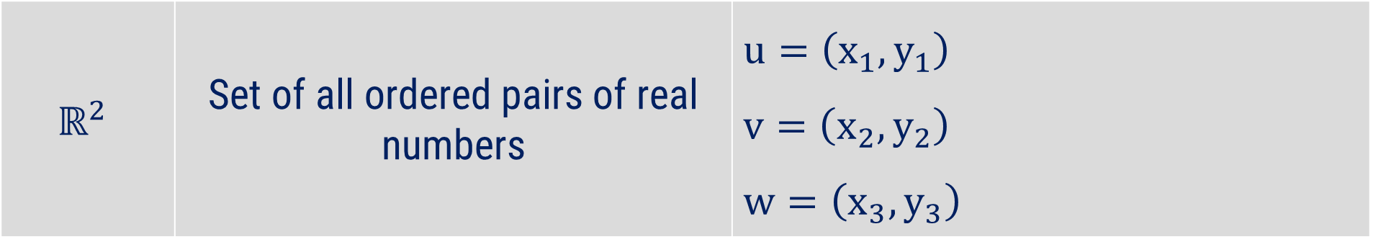
Symbol, Name and Elements of Different Sets
Symbol | Name | Elements of the Set
$$ℝ$$ | Set of all real numbers | $$x, y, z$$
$$ℝ^{+}$$ | Set of all positive real numbers | $$x, y, z$$
$$ℝ^{2}$$ | Set of all ordered pairs of real numbers | $$u=\left(x_{1},y_{1}\right)$$ $$v=\left(x_{2},y_{2}\right)$$ $$w=\left(x_{3},y_{3}\right)$$

Slide 7
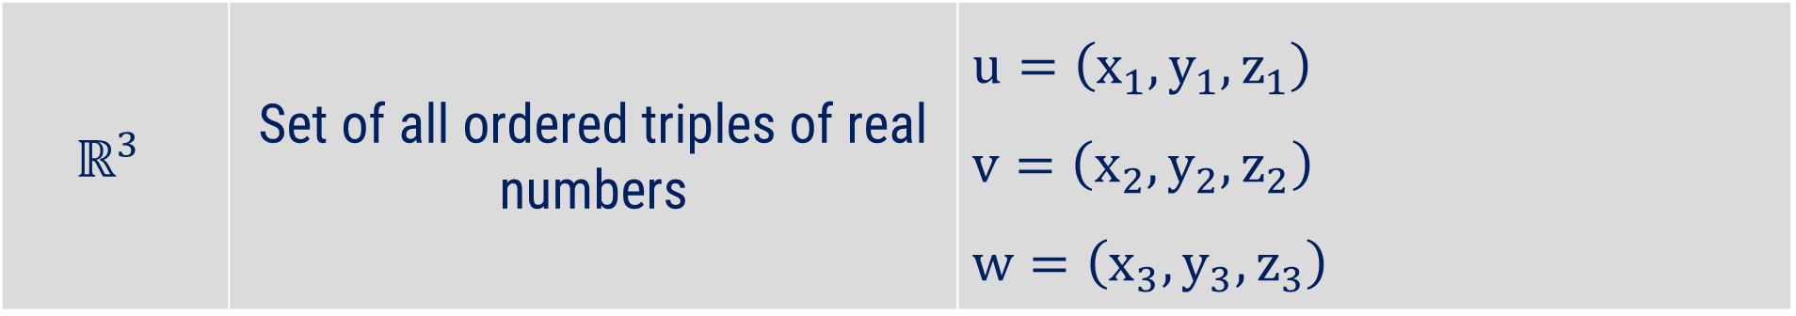
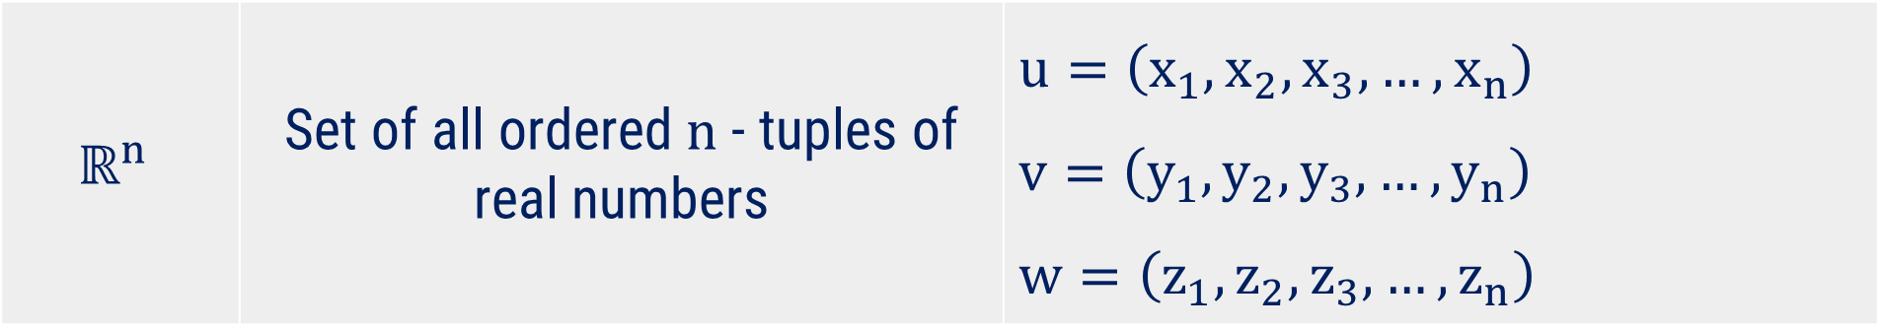
Symbol, Name and Elements of Different Sets
Symbol | Name | Elements of the Set
$$ℝ^{3}$$ | Set of all ordered triples of real numbers | $$u=\left(x_{1},y_{1},z_{1}\right)$$ $$v=\left(x_{2},y_{2},z_{2}\right)$$ $$w=\left(x_{3},y_{3},z_{3}\right)$$
$$ℝ^{n}$$ | Set of all ordered $n$ - tuples of real numbers | $$u=\left(x_{1},x_{2},x_{3},…,x_{n}\right)$$ $$v=\left(y_{1},y_{2},y_{3},…,y_{n}\right)$$ $$w=\left(z_{1},z_{2},z_{3},…,z_{n}\right)$$

Slide 8
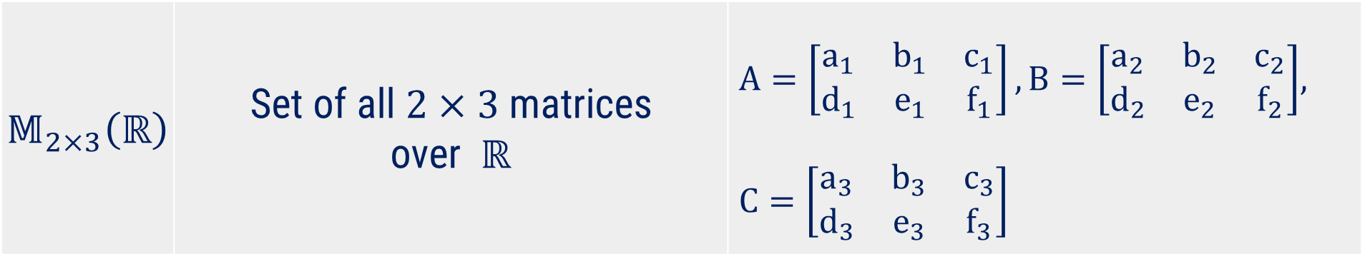
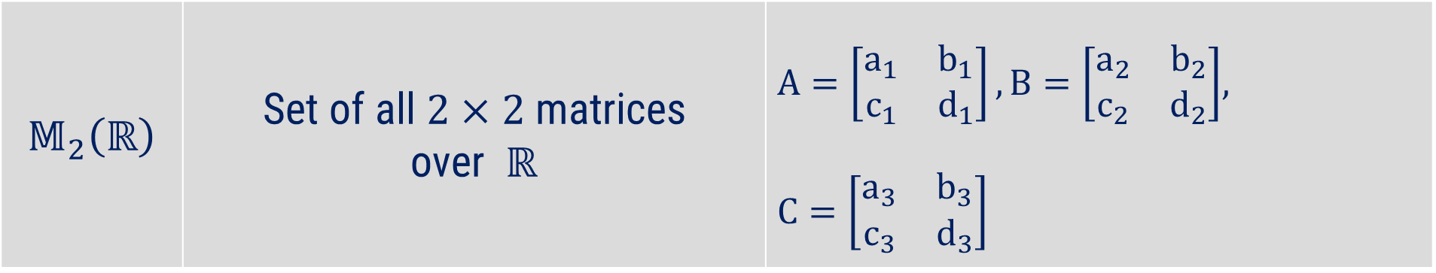
Symbol, Name and Elements of Different Sets
Symbol | Symbol | Elements of the Set
$$𝕄_{2}\left(ℝ\right)$$ | Set of all $2×2$ matrices over $ℝ$ | $A=\left[\begin{matrix}a_{1} & b_{1} \\ c_{1} & d_{1}\end{matrix}\right],B=\left[\begin{matrix}a_{2} & b_{2} \\ c_{2} & d_{2}\end{matrix}\right]$, $$C=\left[\begin{matrix}a_{3} & b_{3} \\ c_{3} & d_{3}\end{matrix}\right]$$
$$𝕄_{2×3}\left(ℝ\right)$$ | Set of all $2×3$ matrices over $ℝ$ | $A=\left[\begin{matrix}a_{1} & b_{1} & c_{1} \\ d_{1} & e_{1} & f_{1}\end{matrix}\right],B=\left[\begin{matrix}a_{2} & b_{2} & c_{2} \\ d_{2} & e_{2} & f_{2}\end{matrix}\right]$, $$C=\left[\begin{matrix}a_{3} & b_{3} & c_{3} \\ d_{3} & e_{3} & f_{3}\end{matrix}\right]$$

Slide 9
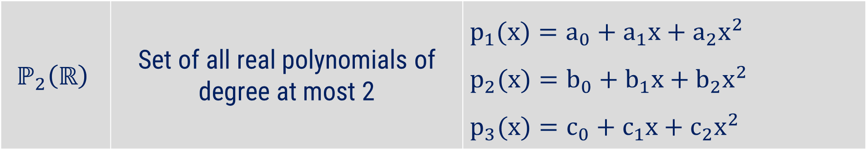
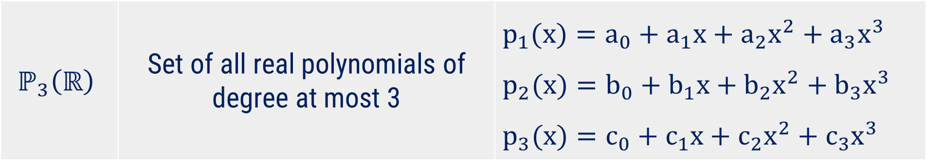
Symbol, Name and Elements of Different Sets
Symbol | Name | Elements of the Set
$$ℙ_{2}\left(ℝ\right)$$ | Set of all real polynomials of degree at most 2 | $$p_{1}(x)=a_{0}+a_{1}x+a_{2}x^{2}$$ $$p_{2}(x)=b_{0}+b_{1}x+b_{2}x^{2}$$ $$p_{3}(x)=c_{0}+c_{1}x+c_{2}x^{2}$$
$$ℙ_{3}\left(ℝ\right)$$ | Set of all real polynomials of degree at most 3 | $$p_{1}(x)=a_{0}+a_{1}x+a_{2}x^{2}+a_{3}x^{3}$$ $$p_{2}(x)=b_{0}+b_{1}x+b_{2}x^{2}+b_{3}x^{3}$$ $$p_{3}(x)=c_{0}+c_{1}x+c_{2}x^{2}+c_{3}x^{3}$$

Slide 10
Method-1
Vector Space

Slide 11
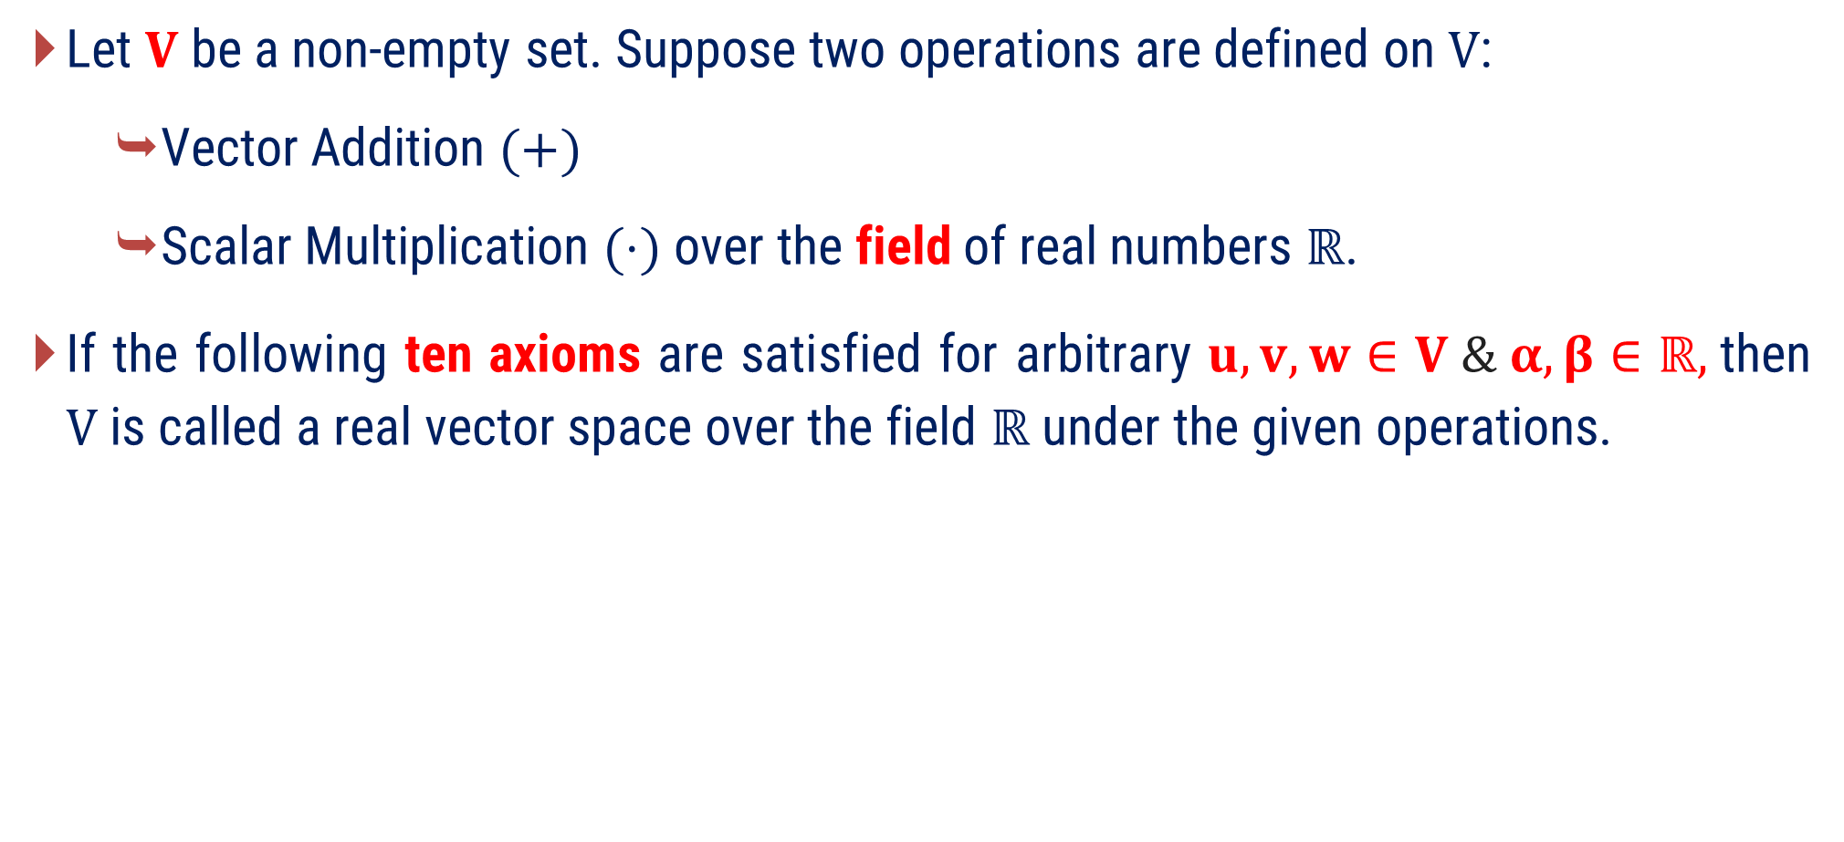
Real Vector Space
Let $V$ be a non-empty set. Suppose two operations are defined on $V$:
  Vector Addition $(+)$
  Scalar Multiplication $(⋅)$ over the field of real numbers $ℝ$.
If the following ten axioms are satisfied for arbitrary $u,v,w∈V \& α,β∈ℝ,$then $V$ is called a real vector space over the field $ℝ$ under the given operations.

Slide 12
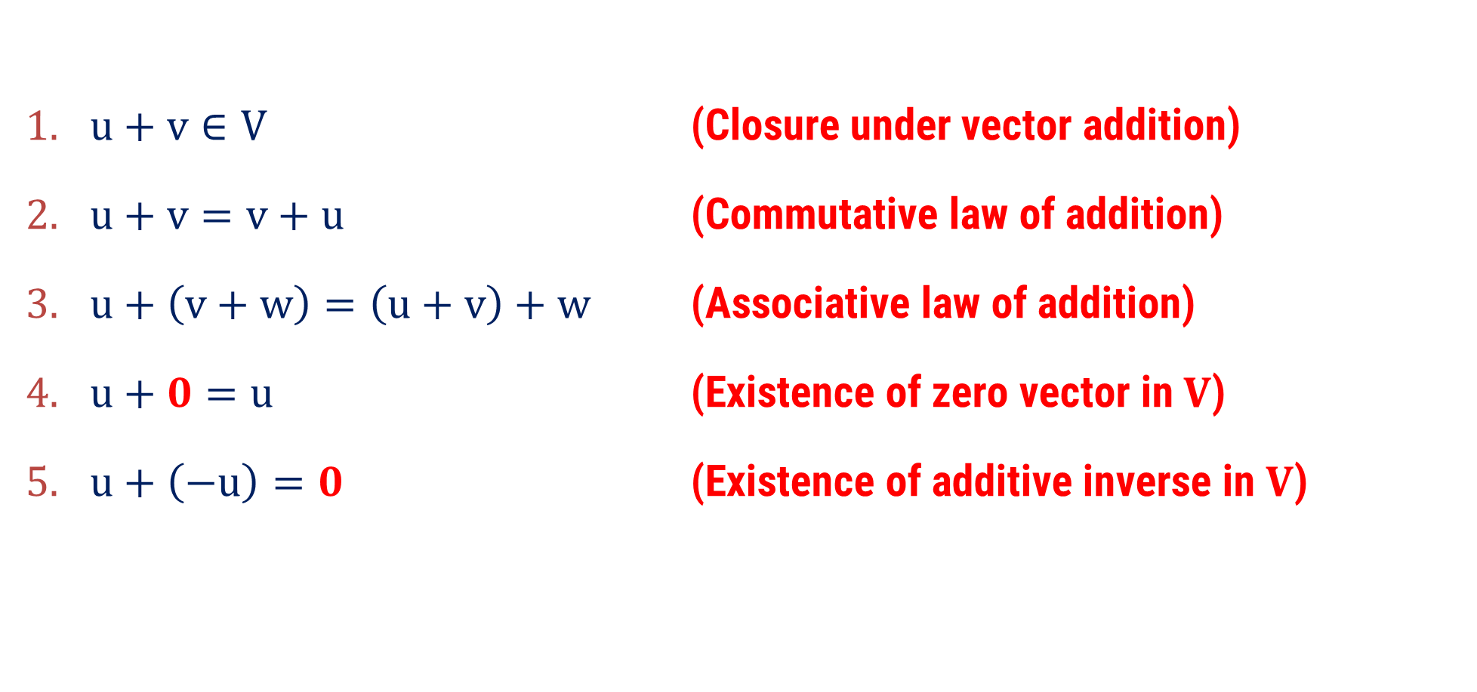
Real Vector Space
Axioms
$u+v∈V$ (Closure under vector addition)
$u+v=v+u$ (Commutative law of addition)
$u+\left(v+w\right)=\left(u+v\right)+w$ (Associative law of addition)
$u+0=u$ (Existence of zero vector in $V$)
$u+\left(−u\right)=0$ (Existence of additive inverse in $V$)
Here, $0$ is a notation of a zero vector, not a number zero

Slide 13
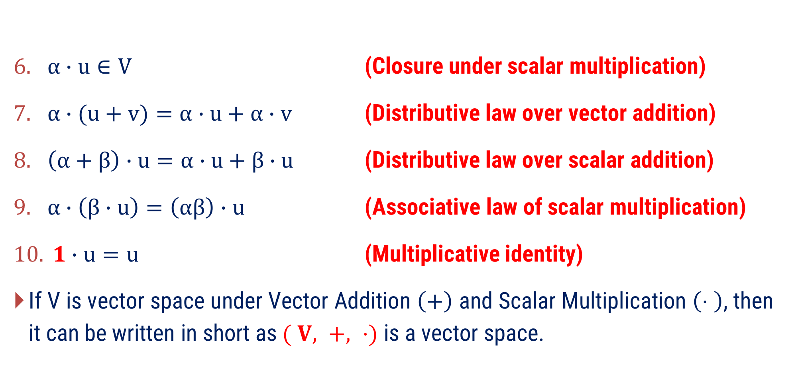
Real Vector Space
Axioms
$α∙u∈V$ (Closure under scalar multiplication)
$α∙(u+v)=α∙u+α∙v$ (Distributive law over vector addition)
$\left(α+β\right)∙u=α∙u+β∙u$ (Distributive law over scalar addition)
$α∙\left(β∙u\right)=\left(αβ\right)∙u$ (Associative law of scalar multiplication)
$1∙u=u$ (Multiplicative identity)
If V is vector space under Vector Addition $\left(+\right)$ and Scalar Multiplication $\left(⋅ \right)$, then it can be written in short as $( V, +, ⋅)$ is a vector space.

Slide 14
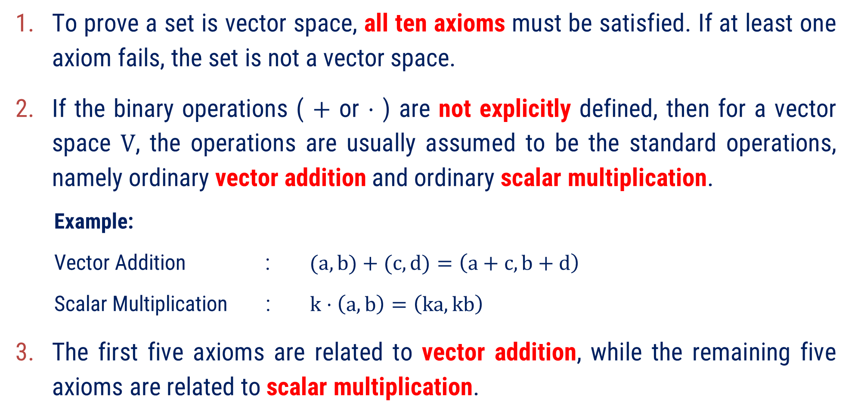
Remarks
To prove a set is vector space, all ten axioms must be satisfied. If at least one axiom fails, the set is not a vector space.
If the binary operations ( $+$ or $⋅$ ) are not explicitly defined, then for a vector
space $V$, the operations are usually assumed to be the standard operations, namely ordinary vector addition and ordinary scalar multiplication.
  Example:
  Vector Addition : $(a,b)+(c,d)=\left(a+c, b+d\right)$
  Scalar Multiplication : $k⋅\left(a,b\right)=\left(ka, kb\right)$
The first five axioms are related to vector addition, while the remaining five axioms are related to scalar multiplication.

Slide 15
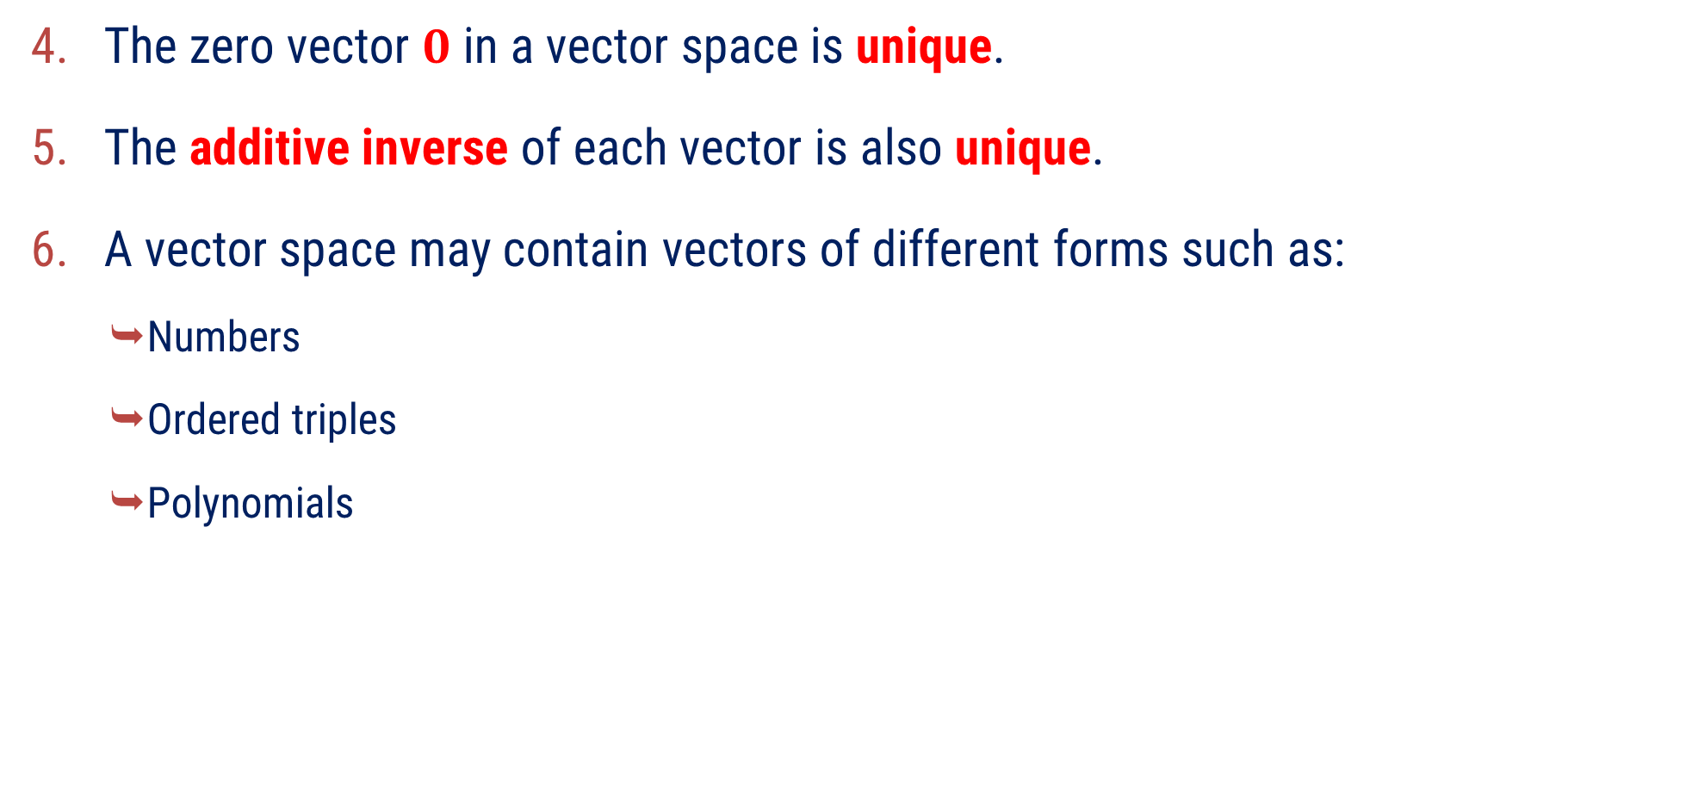
Remarks:
The zero vector $0$ in a vector space is unique.
The additive inverse of each vector is also unique.
A vector space may contain vectors of different forms such as:
  Numbers
  Ordered triples
  Polynomials
  Ordered pairs
  Matrices
  Functions

Slide 16
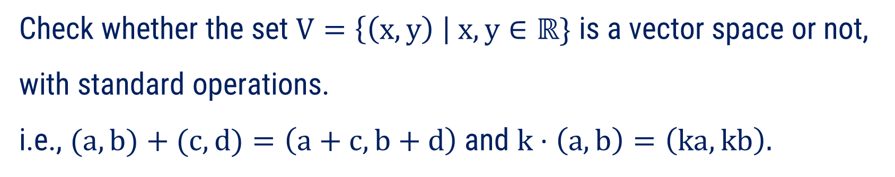
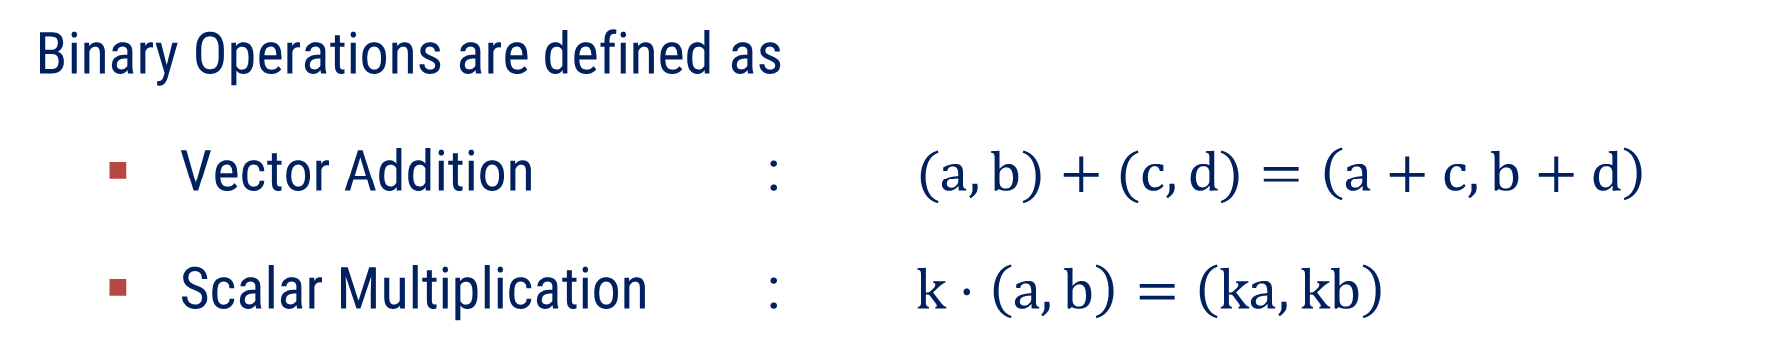

Method:1 $⇝$ Example:5
Example
Check whether the set $V=\left\{\left(x,y\right) \right| x,y∈ℝ\}$ is a vector space or not, with standard operations. i.e., $(a,b)+(c,d)=\left(a+c, b+d\right)$and $k⋅\left(a,b\right)=\left(ka,kb\right).$
Solution
Here, $V=\left\{ \left(x,y\right) \right| x,y∈ℝ \}$
Binary Operations are defined as
Vector Addition : $(a,b)+(c,d)=\left(a+c, b+d\right)$
Scalar Multiplication : $k⋅\left(a,b\right)=\left(ka,kb\right)$
Let us check ten axioms for a vector space.

Slide 17
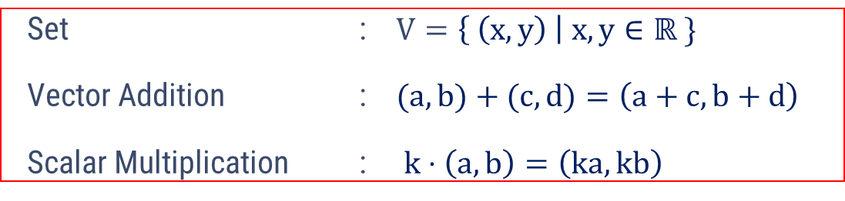









Method:1 $⇝$ Example:5(continue)
Let $u=\left(a_{1},b_{1}\right),v=\left(a_{2},b_{2}\right)$, $w=\left(a_{3},b_{3}\right)$ ∈ $V$
and $k,m∈ℝ$
Axiom 1: $u+v∈V$
Now, $u+v=\left(a_{1},b_{1}\right)+\left(a_{2},b_{2}\right)$
$$=\left(a_{1}+a_{2},b_{1}+b_{2}\right)$$
Since, $\left(a_{1},b_{1}\right),\left(a_{2},b_{2}\right) \text{∈ }V$
$$⇒a_{1},b_{1},a_{2},b_{2}∈ℝ$$
$$⇒a_{1}+a_{2},b_{1}+b_{2}∈ℝ$$
So, $u+v=\left(a_{1}+a_{2},b_{1}+b_{2}\right)∈V$

Slide 18








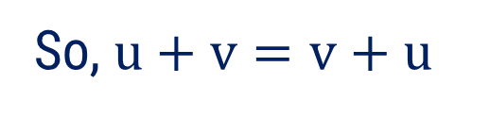




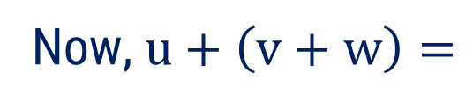

Method:1 $⇝$ Example:5(continue)
Axiom 2: $u+v=v+u$
Now, $u+v=\left(a_{1},b_{1}\right)+\left(a_{2},b_{2}\right)$
$$=\left(a_{1}+a_{2},b_{1}+b_{2}\right)$$
$$=\left(a_{2}+a_{1},b_{2}+b_{1}\right)$$
$$=\left(a_{2},b_{2}\right)+\left(a_{1},b_{1}\right)$$
$$=v+u$$
So, $u+v=v+u$
Axiom 3: $u+\left(v+w\right)=\left(u+v\right)+w$
Now, $u+\left(v+w\right)=$
$$\left(a_{1},b_{1}\right)+\left(a_{2}+a_{3},b_{2}+b_{3}\right)$$
$$=\left(a_{1}+a_{2}+a_{3},b_{1}+b_{2}+b_{3}\right)$$
Now, $\left(u+v\right)+w=$
$$\left(a_{1}+a_{2},b_{1}+b_{2}\right)+\left(a_{3},b_{3}\right)$$
$$=\left(a_{1}+a_{2}+a_{3},b_{1}+b_{2}+b_{3}\right)$$
So, $u+\left(v+w\right)=\left(u+v\right)+w$

Slide 19
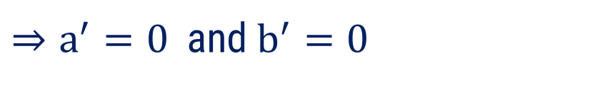

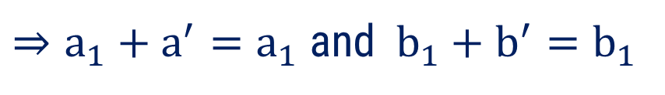




Method:1 $⇝$ Example:5(continue)
Axiom 4: $u+e=u$
Let, $e=\left(a^{′},b^{′}\right)∈V$ such that $u+e=u$.
Now, $u+e=u$
$$⇒\left(a_{1},b_{1}\right)+\left(a^{′},b^{′}\right)=\left(a_{1},b_{1}\right)$$
$$⇒\left(a_{1}+a^{′},b_{1}+b^{′}\right)=\left(a_{1},b_{1}\right)$$
$⇒a_{1}+a^{′}=a_{1}$ and$b_{1}+b^{′}=b_{1}$
$⇒a^{′}=0$and $b^{′}=0$
So, $e=\left(a^{′},b^{′}\right)=\left(0,0\right)$ is the identity element of $V$.

Slide 20


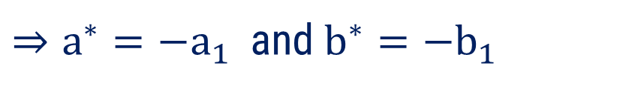

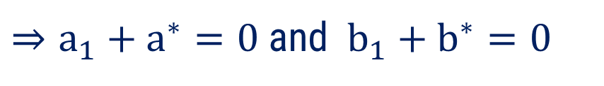

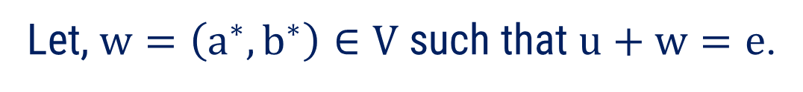
Method:1 $⇝$ Example:5(continue)
Axiom 5: $u+w=e$
Let, $w=\left(a^{∗},b^{∗}\right)∈V$ such that $u+w=e$.
Now, $u+w=e$
$$⇒\left(a_{1},b_{1}\right)+\left(a^{∗},b^{∗}\right)=\left(0,0\right)$$
$$⇒\left(a_{1}+a^{∗},b_{1}+b^{∗}\right)=\left(0,0\right)$$
$⇒a_{1}+a^{∗}=0$ and$b_{1}+b^{∗}=0$
$⇒a^{∗}=−a_{1}$and $b^{∗}=−b_{1}$
So, $w=\left(a^{∗},b^{∗}\right)=\left(−a_{1},−b_{1}\right)$ is the additive inverse of $u=\left(a_{1},b_{1}\right)$.

Slide 21







Method:1 $⇝$ Example:5(continue)
Axiom 6: $k⋅u∈V$
Now, $k⋅u=k⋅\left(a_{1},b_{1}\right)$
$$=\left(ka_{1},kb_{1}\right)$$
Since, $\left(a_{1},b_{1}\right) \text{∈ }V$ and $k∈ℝ$
$$⇒a_{1},b_{1},k∈ℝ$$
$$⇒ka_{1},kb_{1}∈ℝ$$
$$\text{So}\text{, }k⋅u=\left(ka_{1},kb_{1}\right)∈V$$

Slide 22








Method:1 $⇝$ Example:5(continue)
Axiom 7: $k⋅\left(u+v\right)=k⋅u+k⋅v$
Now, $k⋅\left(u+v\right)$
$$=k⋅\left(a_{1}+a_{2},b_{1}+b_{2}\right)$$
$$=\left(k\left(a_{1}+a_{2}\right),k\left(b_{1}+b_{2}\right)\right)$$
$=\left( ka_{1}+ka_{2} , kb_{1}+kb_{2} \right)$
Now, $k⋅u+k⋅v$
$$=k⋅\left(a_{1},b_{1}\right)+k⋅\left(a_{2},b_{2}\right)$$
$$=\left(ka_{1},kb_{1}\right)+\left(ka_{2},kb_{2}\right)$$
$=\left( ka_{1}+ka_{2} , kb_{1}+kb_{2} \right)$
$$\text{So}\text{,} k⋅\left(u+v\right)=k⋅u+k⋅v$$

Slide 23








Method:1 $⇝$ Example:5(continue)
Axiom 8: $\left(k+m\right)⋅u=k⋅u+m⋅u$
Now, $\left(k+m\right)⋅u$
$$=\left(k+m\right)⋅\left(a_{1},b_{1}\right)$$
$$=\left(\left(k+m\right)a_{1},\left(k+m\right)b_{1}\right)$$
$$=\left(ka_{1}+ma_{1},kb_{1}+mb_{1}\right)$$
Now, $k⋅u+m⋅u$
$$=k⋅\left(a_{1},b_{1}\right)+m⋅\left(a_{1},b_{1}\right)$$
$$=\left(ka_{1},kb_{1}\right)+\left(ma_{1},mb_{1}\right)$$
$$=\left(ka_{1}+ma_{1},kb_{1}+mb_{1}\right)$$
$$\text{So}\text{, }\left(k+m\right)⋅u=k⋅u+m⋅u$$

Slide 24







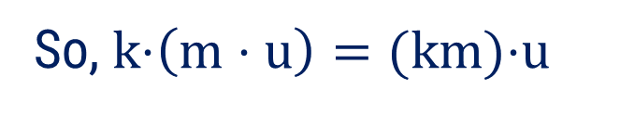
Method:1 $⇝$ Example:5(continue)
Axiom 9: $k⋅\left(m⋅u\right)=\left(km\right)⋅u$
Now, $k\text{⋅}\left(m⋅u\right)$
$=k\text{⋅}\left(m⋅\left(a_{1},b_{1}\right)\right)$
$$=k\text{⋅}\left(ma_{1},mb_{1}\right)$$
$$=\left(kma_{1},kmb_{1}\right)$$
$$=(k\text{m}\text{)⋅}\left(a_{1},b_{1}\right)$$
$$=(k\text{m}\text{)⋅}u$$
So, $k\text{⋅}\left(m⋅u\right)=(k\text{m}\text{)⋅}u$

Slide 25
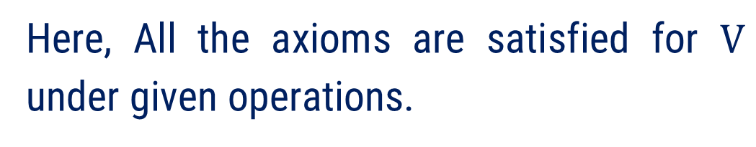






Method:1 $⇝$ Example:5(continue)
Axiom 10: $1⋅u=u$
Now, $1\text{⋅} u$
$$=1\text{⋅}\left(a_{1},b_{1}\right)$$
$$=\left(a_{1},b_{1}\right)$$
$$=u$$
Here, All the axioms are satisfied for $V$ under given operations.
Hence, $\left( V , + , ⋅ \right)$ is a vector space.

Slide 26
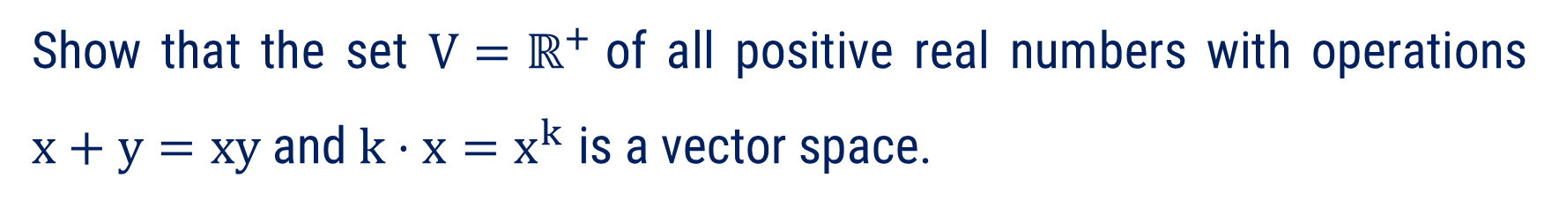
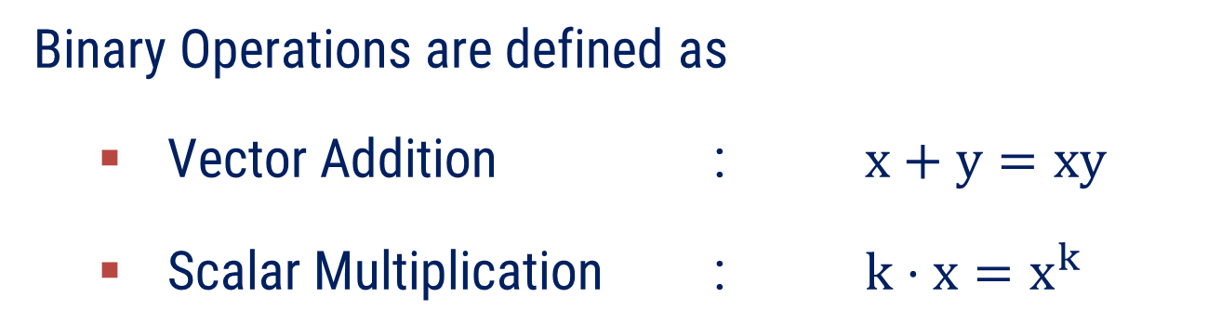


Method:1 $⇝$ Example:1
Example
Show that the set $V=ℝ^{+}$of all positive real numbers with operations $x+y=xy$and $k⋅x=x^{k}$ is a vector space.
Solution
Here, $V= ℝ^{+}$of all positive real numbers
$$=\left\{ x | x>0 \& x∈ℝ \right\}$$
Binary Operations are defined as
Vector Addition : $x+y=xy$
Scalar Multiplication : $k⋅x=x^{k}$
Let us check ten axioms for a vector space.

Slide 27
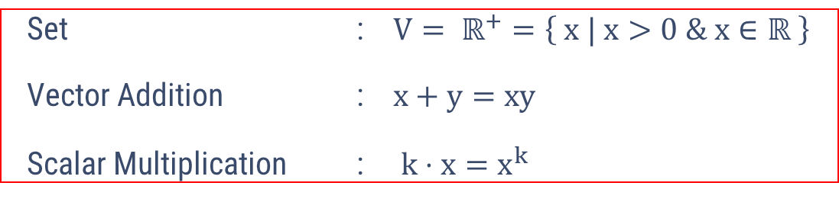
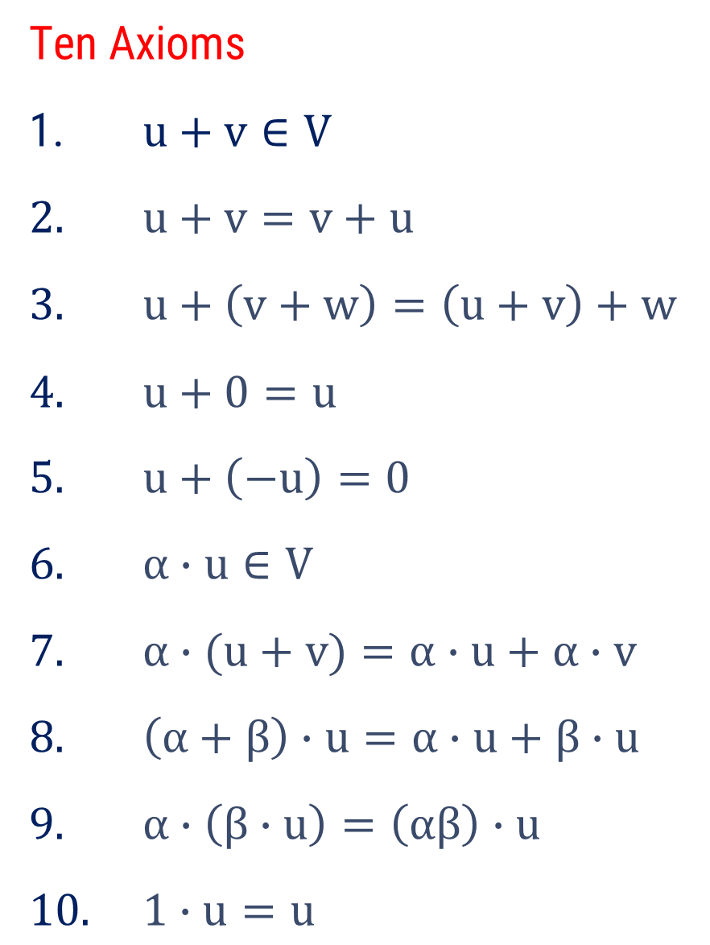





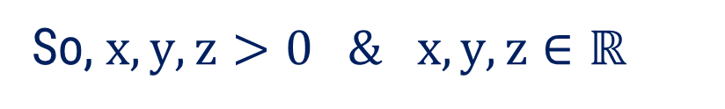




Method:1 $⇝$ Example:1(continue)
Let $x, y$, $z$ ∈ $V=ℝ^{+}$ and $k,m∈ℝ$
So, $x,y,z>0 \& x,y,z∈ℝ$
Axiom 1: $x+y∈V$
Since, $x>0, y>0$
$$⇒ xy>0$$
Now, $x+y=xy$
$$>0$$
$$⇒ x+y>0$$
$$\& x+y∈ℝ$$
$$⇒ x+y∈V=ℝ^{+}$$

Slide 28



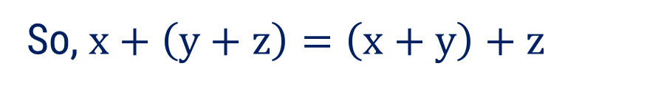

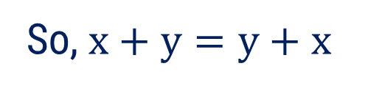



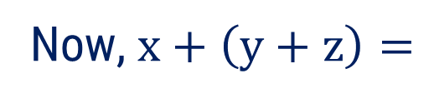



Method:1 $⇝$ Example:1(continue)
Axiom 2: $x+y=y+x$
Now, $x+y=xy$
$$=yx$$
$$=y+x$$
So, $x+y=y+x$
Axiom 3: $x+\left(y+z\right)=\left(x+y\right)+z$
Now, $x+\left(y+z\right)=$
$$x+\left(yz\right)$$
$$=xyz$$
Now, $\left(x+y\right)+z=$
$$\left(xy\right)+z$$
$$=xyz$$
So, $x+\left(y+z\right)=\left(x+y\right)+z$

Slide 29
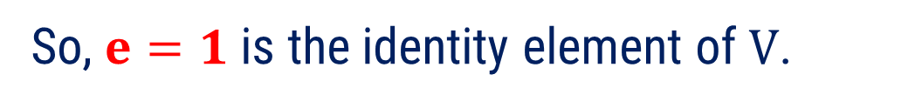





Method:1 $⇝$ Example:1(continue)
Axiom 4: $x+e=x$
Let, $e∈ℝ^{+}$ such that $x+e=x$.
Now, $x+e=x$
$$⇒ex=x$$
$$⇒e=1∈ℝ^{+}$$
So, $e=1$ is the identity element of $V$.
In general, we use 1 instead of 0.

Slide 30






Method:1 $⇝$ Example:1(continue)
Axiom 5: $x+w=1$
Let, $w∈ℝ^{+}$ such that $x+w=1$.
Now, $x+w=1$
$$⇒xw=1$$
$$⇒w=\frac{1}{ x }∈ℝ^{+}$$
So, $w=\frac{1}{ x }$ is the additive inverse of $x$.

Slide 31







Method:1 $⇝$ Example:1(continue)
Axiom 6: $k⋅x∈V$
Since, $x>0, k∈ℝ$
$$⇒ x^{k}>0$$
$$\& x^{k}∈ℝ$$
$$⇒k⋅x>0$$
$$\& k⋅x∈ℝ$$
$$⇒k⋅x∈V$$

Slide 32








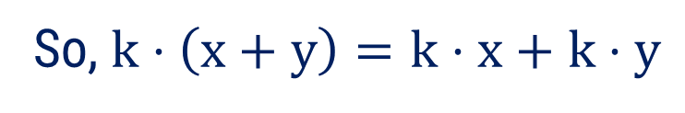
Method:1 $⇝$ Example:1(continue)
Axiom 7: $k⋅\left(x+y\right)=k⋅x+k⋅y$
Now, $k⋅\left(x+y\right)$
$$=k⋅\left(xy\right)$$
$$={\left(xy\right)}^{k}$$
$$=x^{k}y^{k}$$
$$=\left(k⋅x\right)\left(k⋅y\right)$$
$$\left[∵k⋅x=x^{k} \right]$$
$$=k⋅x+k⋅y$$
So, $k⋅\left(x+y\right)=k⋅x+k⋅y$

Slide 33







Method:1 $⇝$ Example:1(continue)
Axiom 8: $\left(k+m\right)⋅x=k⋅x+m⋅x$
Now,$\left(k+m\right)⋅x$
$$=x^{k+m}$$
$$=\left(x^{k}\right)\left(x^{m}\right)$$
$$=x^{k}+x^{m}$$
$$=k⋅x+m⋅x$$
So, $\left(k+m\right)⋅x=k⋅x+m⋅x$

Slide 34








Method:1 $⇝$ Example:1(continue)
Axiom 9: $k⋅\left(m⋅x\right)=\left(km\right)⋅x$
Now, $k\text{⋅}\left(m⋅x\right)$
$$=k\text{⋅}\left(x^{m}\right)$$
$$={\left(x^{m}\right)}^{k}$$
$$=x^{mk}$$
$$=x^{km}$$
$$=(k\text{m}\text{)⋅}x$$
So, $k\text{⋅}\left(m⋅x\right)=(k\text{m}\text{)⋅}x$

Slide 35




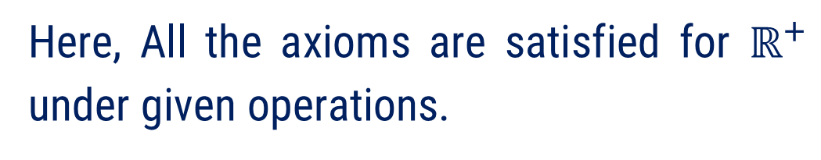

Method:1 $⇝$ Example:1(continue)
Axiom 10: $1⋅x=x$
Now, $1\text{⋅} x$
$$=x^{1}$$
$$=x$$
Here, All the axioms are satisfied for $ℝ^{+}$ under given operations.
Hence, $\left( ℝ^{+} , + , ⋅ \right)$ is a vector space.

Slide 36
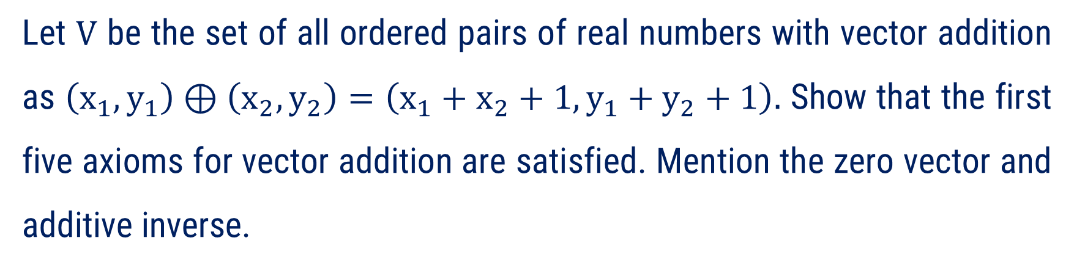
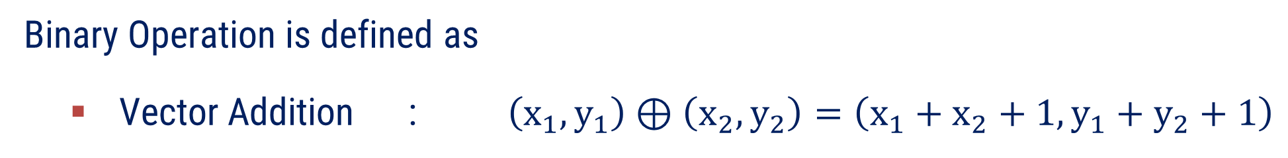
Method:1 $⇝$ Example:8
Example
Let $V$ be the set of all ordered pairs of real numbers with vector addition as $\left(x_{1},y_{1}\right)⊕\left(x_{2},y_{2}\right)=\left(x_{1}+x_{2}+1,y_{1}+y_{2}+1\right).$ Show that the first five axioms for vector addition are satisfied. Mention the zero vector and additive inverse.
Solution
Here, $V=$Set of all ordered pairs of real numbers$=\left\{ \left(x,y\right) \right| x,y∈ℝ \}$
Binary Operation is defined as
Vector Addition : $\left(x_{1},y_{1}\right)⊕\left(x_{2},y_{2}\right)=\left(x_{1}+x_{2}+1,y_{1}+y_{2}+1\right)$
Let us check first five axioms for a vector space.

Slide 37
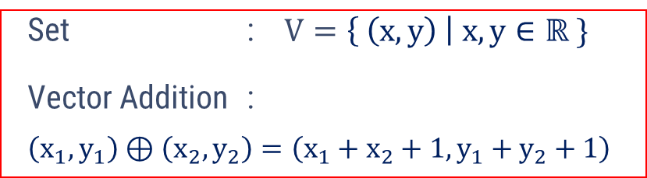






Method:1 $⇝$ Example:8(continue)
Let $u=\left(a_{1},b_{1}\right),v=\left(a_{2},b_{2}\right)$, $w=\left(a_{3},b_{3}\right)$ ∈ $V$
and $k,m∈ℝ$
Axiom 1: $u⊕v∈V$
Now, $u⊕v=\left(a_{1},b_{1}\right)⊕\left(a_{2},b_{2}\right)$
$$=\left(a_{1}+a_{2}+1,b_{1}+b_{2}+1\right)$$
Since, $\left(a_{1},b_{1}\right),\left(a_{2},b_{2}\right) \text{∈ }V, 1∈ℝ$
$$⇒a_{1},b_{1},a_{2},b_{2},1∈ℝ$$
$$⇒a_{1}+a_{2}+1, and b_{1}+b_{2}+1∈ℝ$$
So, $u+v=\left(a_{1}+a_{2}+1,b_{1}+b_{2}+1\right)∈V$

Slide 38







Method:1 $⇝$ Example:8(continue)
Axiom 2: $u⊕v=v⊕u$
Now, $u⊕v=\left(a_{1},b_{1}\right)⊕\left(a_{2},b_{2}\right)$
$$=\left(a_{1}+a_{2}+1,b_{1}+b_{2}+1\right)$$
$$=\left(a_{2}+a_{1}+1,b_{2}+b_{1}+1\right)$$
$$=\left(a_{2},b_{2}\right)⊕\left(a_{1},b_{1}\right)$$
$$=v⊕u$$
So, $u⊕v=v⊕u$

Slide 39




Method:1 $⇝$ Example:8(continue)
Axiom 3: $u⊕\left(v⊕w\right)=\left(u⊕v\right)⊕w$
Now, $u⊕\left(v⊕w\right)$
$$=\left(a_{1},b_{1}\right)⊕\left(a_{2}+a_{3}+1,b_{2}+b_{3}+1\right)$$
$$=\left(a_{1}+a_{2}+a_{3}+1+1,b_{1}+b_{2}+b_{3}+1+1\right)$$
$$=\left(a_{1}+a_{2}+a_{3}+1+1,b_{1}+b_{2}+b_{3}+1+1\right)$$
$$=\left(a_{1}+a_{2}+a_{3}+2,b_{1}+b_{2}+b_{3}+2\right)$$
Now, $\left(u⊕v\right)⊕w$
$$=\left(a_{1}+a_{2}+1,b_{1}+b_{2}+1\right)⊕\left(a_{3},b_{3}\right)$$
$$=\left(a_{1}+a_{2}+1+a_{3}+1, b_{1}+b_{2}+1+b_{3}+1\right)$$
$$=\left(a_{1}+a_{2}+1+a_{3}+1, b_{1}+b_{2}+1+b_{3}+1\right)$$
$$=\left(a_{1}+a_{2}+a_{3}+2,b_{1}+b_{2}+b_{3}+2\right)$$
So, $u⊕\left(v⊕w\right)=\left(u⊕v\right)⊕w$

Slide 40

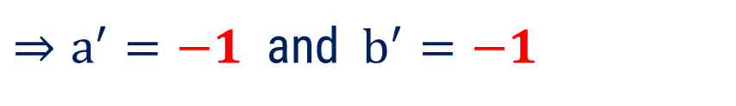

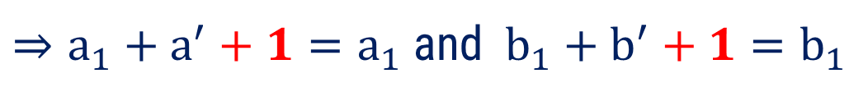



Method:1 $⇝$ Example:8(continue)
Axiom 4: $u⊕e=u$
Let, $e=\left(a^{′},b^{′}\right)∈V$ such that $u⊕e=u$.
Now, $u⊕e=u$
$$⇒\left(a_{1},b_{1}\right)⊕\left(a^{′},b^{′}\right)=\left(a_{1},b_{1}\right)$$
$$⇒\left(a_{1}+a^{′}+1,b_{1}+b^{′}+1\right)=\left(a_{1},b_{1}\right)$$
$⇒a_{1}+a^{′}+1=a_{1}$ and$b_{1}+b^{′}+1=b_{1}$
$⇒a^{′}=−1$ and $b^{′}=−1$
So, $\left(a^{′},b^{′}\right)=\left(−1,−1\right)$ is the identity element of $V$.
In general, we use $\left(−1,−1\right)$ instead of 0.

Slide 41

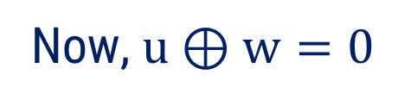
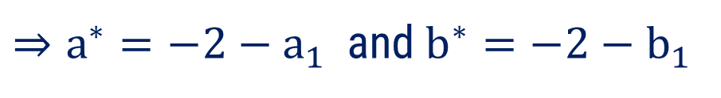

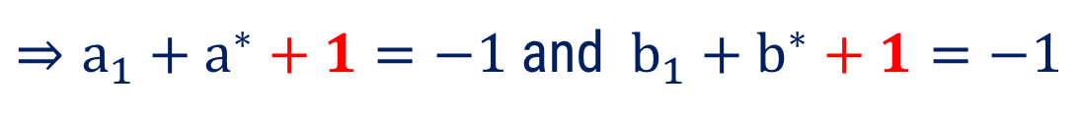

Method:1 $⇝$ Example:8(continue)
Axiom 5: $u⊕w=0$
Let, $w=\left(a^{∗},b^{∗}\right)∈V$ such that $u⊕w=0$.
Now, $u⊕w=0$
$$⇒\left(a_{1},b_{1}\right)⊕\left(a^{∗},b^{∗}\right)=\left(−1,−1\right)$$
$$⇒\left(a_{1}+a^{∗}+1,b_{1}+b^{∗}+1\right)=\left(−1,−1\right)$$
$⇒a_{1}+a^{∗}+1=−1$ and$b_{1}+b^{∗}+1=−1$
$⇒a^{∗}=−2−a_{1}$and $b^{∗}=−2−b_{1}$
So, $\left(a^{∗},b^{∗}\right)=\left(−2−a_{1},−2−b_{1}\right)$ $∈V$ is the additive inverse of $\left(a_{1},b_{1}\right)$.

Slide 42
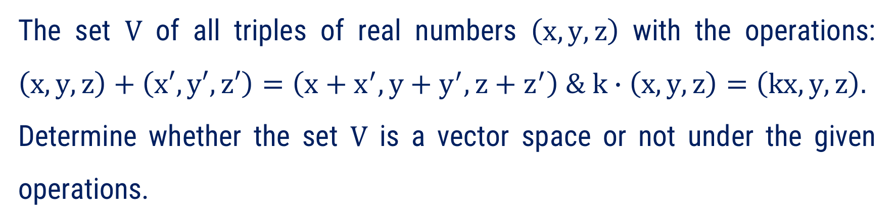
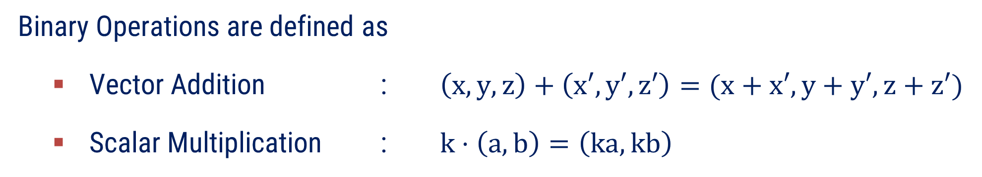
Method:1 $⇝$ Example:11
The set $V$ of all triples of real numbers $\left(x,y,z\right)$ with the operations: $\left(x,y,z\right)+\left(x′,y′,z′\right)=\left(x+x^{′},y+y^{′}, z+z^{′}\right) \& k∙\left(x,y,z\right)=\left(kx,y,z\right).$ Determine whether the set $V$ is a vector space or not under the given operations.
Example
Solution
Here, $V=$Set of all triples of real numbers$=\left\{ \left(x,y, z\right) \right| x,y, z∈ℝ \}$
Binary Operations are defined as
Vector Addition : $\left(x,y,z\right)+\left(x′,y′,z′\right)=(x+x′,y+y′, z+z′)$
Scalar Multiplication : $k⋅\left(a,b\right)=\left(ka,kb\right)$
Let us check axioms for a vector space.

Slide 43
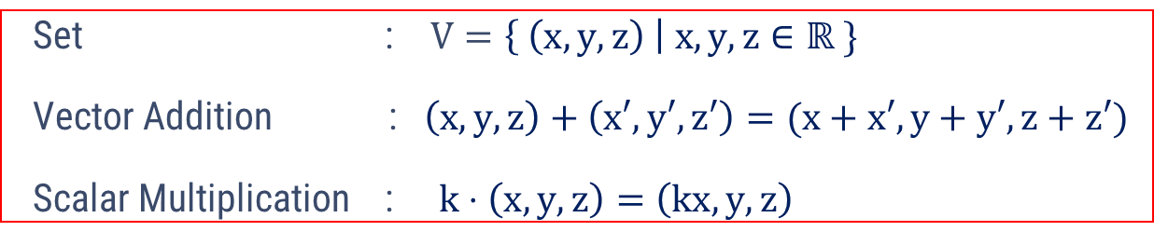





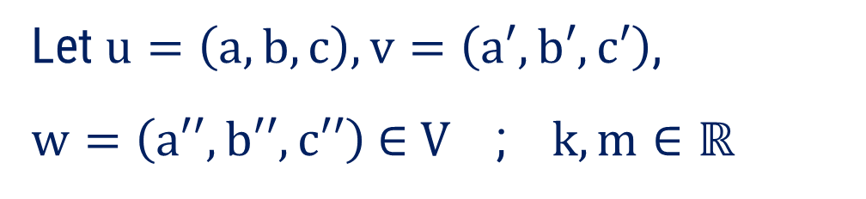

Method:1 $⇝$ Example:11(continue)
Let $u=\left(a,b,c\right),v=\left(a′,b′,c′\right)$,
$w=\left(a′′,b′′,c′′\right)$ ∈ $V$ ; $k,m∈ℝ$
Axiom 1: $u+v∈V$
Now, $u+v=\left(a,b,c\right)+\left(a′,b′,c′\right)$
$$=\left(a+a′,b+b′,c+c′\right)$$
Since, $\left(a,b,c\right),\left(a′,b′,c′\right) \text{∈ } V$
$$⇒a,b,c,a′,b′,c′∈ℝ$$
$$⇒a+b+c,a′+b′+c′∈ℝ$$
So, $u+v=\left(a+a′,b+b′,c+c′\right)∈V$

Slide 44



Method:1 $⇝$ Example:11(continue)
Axiom 2: $u+v=v+u$
Now, $u+v=\left(a,b,c\right)+\left(a′,b′,c′\right)$
$$=\left(a+a′,b+b′,c+c′\right)$$
$$=\left(a′+a,b′+b,c′+c\right)$$
So, $u+v=v+u$

Slide 45




Method:1 $⇝$ Example:11(continue)
Axiom 3: $u+\left(v+w\right)=\left(u+v\right)+w$
Now, $u+\left(v+w\right)$
$$=\left(a,b,c\right)+\left(a^{′}+a^{′′},b^{′}+b^{′′},c^{′}+c′′\right)$$
$$=\left(a+a^{′}+a^{′′},b+b^{′}+b^{′′},c+c′+c′′\right)$$
Now,$\left(u+v\right)+w$
$$=\left(a+a^{′},b+b^{′},c+c′\right)+\left(a′′,b′′,c′′\right)$$
$$=\left(a+a^{′}+a^{′′},b+b^{′}+b^{′′},c+c′+c′′\right)$$
So, $u+\left(v+w\right)=\left(u+v\right)+w$

Slide 46

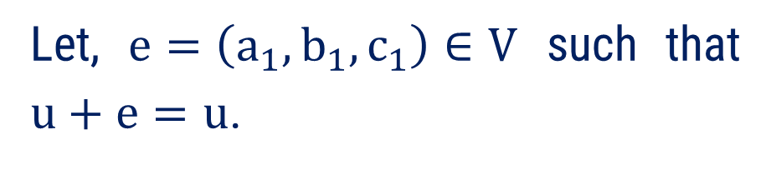


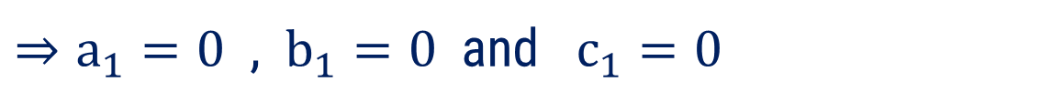
Method:1 $⇝$ Example:11(continue)
Axiom 4: $u+e=u$
Let, $e=\left(a_{1},b_{1},c_{1}\right)∈V$ such that $u+e=u$.
In general, we use $\left(0,0,0\right)$ instead of 0.
Now, $u+e=u$
$$⇒\left(a,b,c\right)+\left(a_{1},b_{1},c_{1}\right)=\left(a,b,c\right)$$
$$⇒\left(a+a_{1},b+b_{1},c+c_{1}\right)=\left(a,b,c\right)$$
$⇒a+a_{1}=a$ , $b+b_{1}=b$ and $c+c_{1}=c$
$⇒a_{1}=0$ , $b_{1}=0$ and $c_{1}=0$
So, $\left(a_{1},b_{1},c_{1}\right)=\left(0,0,0\right)$ is the identity element of $V$.

Slide 47
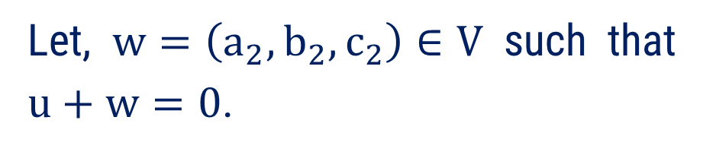




Method:1 $⇝$ Example:11(continue)
Axiom 5: $u+w=0$
Let, $w=\left(a_{2},b_{2},c_{2}\right)∈V$ such that $u+w=0$.
Now, $u+w=0$
$$⇒\left(a,b,c\right)+\left(a_{2},b_{2},c_{2}\right)=\left(0,0,0\right)$$
$$⇒\left(a+a_{2},b+b_{2},c+c_{2}\right)=\left(0,0,0\right)$$
$⇒a+a_{2}=0$ , $b+b_{2}=0$ and $c+c_{2}=0$
$⇒a_{2}=−a$ , $b_{2}=−b$ and $c_{2}=−c$
So, $\left(a_{2},b_{2},c_{2}\right)=\left(−a,−b, −c\right)$ is the additive inverse.

Slide 48







Method:1 $⇝$ Example:11(continue)
Axiom 6: $k\text{⋅}u∈V$
Now, $k⋅u=k\text{⋅}\left(a,b,c\right)$
$$=\left(ka,b,c\right)$$
Since, $\left(a,b,c\right) \text{∈ }V$ and $k∈ℝ$
$$⇒a,b,c,k∈ℝ$$
$$⇒ka,b,c∈ℝ$$
$$\text{So}\text{, }k⋅u=\left(ka,b,c\right)∈V$$

Slide 49





Method:1 $⇝$ Example:11(continue)
Axiom 7: $k⋅\left(u+v\right)=k⋅u+k⋅v$
Now, $k⋅\left(u+v\right)$
$$=k⋅\left(a+a′,b+b′,c+c′\right)$$
$$=\left(ka+ka′,b+b′,c+c′\right)$$
Now, $k⋅u+k⋅v$
$$=k⋅\left(a,b,c\right)+k⋅\left(a′,b′,c′\right)$$
$$=\left(ka,b,c\right)+\left(ka′,b′,c′\right)$$
$$=\left(ka+ka′,b+b′,c+c′\right)$$
$$\text{So}\text{,} k⋅\left(u+v\right)=k⋅u+k⋅v$$

Slide 50









Method:1 $⇝$ Example:11(continue)
Axiom 8: $\left(k+m\right)⋅u=k⋅u+m⋅u$
Now, $\left(k+m\right)⋅u$
$$=\left(k+m\right)⋅\left(a,b,c\right)$$
$$=\left(\left(k+m\right)a,b, c\right)$$
$$=\left(ka+ma,b,c\right)$$
Now, $k⋅u+m⋅u$
$$=k⋅\left(a,b,c\right)+m⋅\left(a,b,c\right)$$
$$=\left(ka,b,c\right)+\left(ma,b,c\right)$$
$$=\left(ka+ma,2b,2c\right)$$
$$\text{So}\text{, }\left(k+m\right)⋅u≠k⋅u+m⋅u$$
Hence, $\left( V , + , ⋅ \right)$ is not a vector space.

Slide 51


Method:1 $⇝$ Example:13
Example
Check the set of $2×2$ matrices, $V=\left\{ \left[ \begin{matrix}a & 1 \\ 1 & b\end{matrix} \right] / a, b∈ℝ\right\}$
is a vector space or not under $\left[ \begin{matrix}a & 1 \\ 1 & b\end{matrix} \right]+\left[ \begin{matrix}x & 1 \\ 1 & y\end{matrix} \right]=\left[ \begin{matrix}a+x & 1 \\ 1 & b+y\end{matrix} \right]$
and $k⋅\left[ \begin{matrix}a & 1 \\ 1 & b\end{matrix} \right]=\left[ \begin{matrix}ka & 1 \\ 1 & kb\end{matrix} \right]$.
Here, $V= \left\{ \left[ \begin{matrix}a & 1 \\ 1 & b\end{matrix} \right] / a, b∈ℝ\right\}$
Solution
Binary Operations are defined as
Vector Addition : $\left[ \begin{matrix}a & 1 \\ 1 & b\end{matrix} \right]+\left[ \begin{matrix}x & 1 \\ 1 & y\end{matrix} \right]=\left[ \begin{matrix}a+x & 1 \\ 1 & b+y\end{matrix} \right]$
Scalar Multiplication : $k⋅\left[ \begin{matrix}a & 1 \\ 1 & b\end{matrix} \right]=\left[ \begin{matrix}ka & 1 \\ 1 & kb\end{matrix} \right]$
There is no impact of Binary Operation

Slide 52









Method:1 $⇝$ Example:13(continue)
Let $u=\left[ \begin{matrix}a_{1} & 1 \\ 1 & b_{1}\end{matrix} \right],v=\left[ \begin{matrix}a_{2} & 1 \\ 1 & b_{2}\end{matrix} \right]$,
$w=\left[ \begin{matrix}a_{3} & 1 \\ 1 & b_{3}\end{matrix} \right]$ ∈ $V$ ; $k,m∈ℝ$
Axiom 1: $u+v∈V$
Now, $u+v=\left[ \begin{matrix}a_{1} & 1 \\ 1 & b_{1}\end{matrix} \right]+\left[ \begin{matrix}a_{2} & 1 \\ 1 & b_{2}\end{matrix} \right]$
Since, $\left[ \begin{matrix}a_{1} & 1 \\ 1 & b_{1}\end{matrix} \right]\&\left[ \begin{matrix}a_{2} & 1 \\ 1 & b_{2}\end{matrix} \right]\text{∈ } V$
$$=\left[ \begin{matrix}a_{1}+a_{2} & 1 \\ 1 & b_{1}+b_{2}\end{matrix} \right]$$
$$⇒a_{1},b_{1},a_{2},b_{2}∈ℝ$$
$$⇒a_{1}+b_{1},a_{2}+b_{2}∈ℝ$$
So, $u+v∈V$

Slide 53





Method:1 $⇝$ Example:13(continue)
Axiom 2: $u+v=v+u$
Now, $u+v$
$$=\left[ \begin{matrix}a_{1} & 1 \\ 1 & b_{1}\end{matrix} \right]+\left[ \begin{matrix}a_{2} & 1 \\ 1 & b_{2}\end{matrix} \right]$$
$$=\left[ \begin{matrix}a_{1}+a_{2} & 1 \\ 1 & b_{1}+b_{2}\end{matrix} \right]$$
$$=\left[ \begin{matrix}a_{2}+a_{1} & 1 \\ 1 & b_{2}+b_{1}\end{matrix} \right]$$
So, $u+v=v+u$

Slide 54




Method:1 $⇝$ Example:13(continue)
Axiom 3: $u+\left(v+w\right)=\left(u+v\right)+w$
Now, $u+\left(v+w\right)$
$=\left[ \begin{matrix}a_{1} & 1 \\ 1 & b_{1}\end{matrix} \right]+\left( \left[ \begin{matrix}a_{2} & 1 \\ 1 & b_{2}\end{matrix} \right]+\left[ \begin{matrix}a_{3} & 1 \\ 1 & b_{3}\end{matrix} \right] \right)$
$$=\left[ \begin{matrix}a_{1} & 1 \\ 1 & b_{1}\end{matrix} \right]+\left[ \begin{matrix}a_{2}+a_{3} & 1 \\ 1 & b_{2}+b_{3}\end{matrix} \right]$$
$$=\left[ \begin{matrix}a_{1}+a_{2}+a_{3} & 1 \\ 1 & b_{1}+b_{2}+b_{3}\end{matrix} \right]$$
$$……\left(1\right)$$

Slide 55





Method:1 $⇝$ Example:13(continue)
Axiom 3: $u+\left(v+w\right)=\left(u+v\right)+w$
Now,$\left(u+v\right)+w$
$$=\left( \left[ \begin{matrix}a_{1} & 1 \\ 1 & b_{1}\end{matrix} \right]+\left[ \begin{matrix}a_{2} & 1 \\ 1 & b_{2}\end{matrix} \right] \right)+\left[ \begin{matrix}a_{3} & 1 \\ 1 & b_{3}\end{matrix} \right]$$
$$=\left[ \begin{matrix}a_{1}+a_{2} & 1 \\ 1 & b_{1}+b_{2}\end{matrix} \right]+\left[ \begin{matrix}a_{3} & 1 \\ 1 & b_{3}\end{matrix} \right]$$
$$=\left[ \begin{matrix}a_{1}+a_{2}+a_{3} & 1 \\ 1 & b_{1}+b_{2}+b_{3}\end{matrix} \right]$$
$$……\left(2\right)$$
So From eq. (1) and (2), $u+\left(v+w\right)=\left(u+v\right)+w$

Slide 56







Method:1 $⇝$ Example:13(continue)
Axiom 4: $u+e=u$
Let, $e=\left[ \begin{matrix}a^{′} & 1 \\ 1 & b^{′}\end{matrix} \right]∈V$ such that $u+e=u$.
Now, $u+e=u$
$$⇒\left[ \begin{matrix}a_{1} & 1 \\ 1 & b_{1}\end{matrix} \right]+\left[ \begin{matrix}a^{′} & 1 \\ 1 & b^{′}\end{matrix} \right]=\left[ \begin{matrix}a_{1} & 1 \\ 1 & b_{1}\end{matrix} \right]$$
So, $\left[ \begin{matrix}a^{′} & 1 \\ 1 & b^{′}\end{matrix} \right]=\left[ \begin{matrix}0 & 1 \\ 1 & 0\end{matrix} \right]$ is the identity element of $V$.
$$⇒\left[ \begin{matrix}a_{1}+a′ & 1 \\ 1 & b_{1}+b′\end{matrix} \right]=\left[ \begin{matrix}a_{1} & 1 \\ 1 & b_{1}\end{matrix} \right]$$
$⇒a_{1}+a′=a_{1}$ and $b_{1}+b′=b_{1}$
$⇒a′=0$ and $b^{′}=0$

Slide 57







Method:1 $⇝$ Example:13(continue)
Axiom 5: $u+w=e$
Let, $w=\left[ \begin{matrix}a^{∗} & 1 \\ 1 & b^{∗}\end{matrix} \right]∈V$ such that $u+w=e$.
Now, $u+w=e$
So, $w=\left[ \begin{matrix}a^{∗} & 1 \\ 1 & b^{∗}\end{matrix} \right]=\left[ \begin{matrix}−a_{1} & 1 \\ 1 & −b_{1}\end{matrix} \right]$ is the additive inverse of $u$.
$$⇒\left[ \begin{matrix}a_{1} & 1 \\ 1 & b_{1}\end{matrix} \right]+\left[ \begin{matrix}a^{∗} & 1 \\ 1 & b^{∗}\end{matrix} \right]=\left[ \begin{matrix}0 & 1 \\ 1 & 0\end{matrix} \right]$$
$$⇒\left[ \begin{matrix}a_{1}+a^{∗} & 1 \\ 1 & b_{1}+b^{∗}\end{matrix} \right]=\left[ \begin{matrix}0 & 1 \\ 1 & 0\end{matrix} \right]$$
$⇒a_{1}+a^{∗}=0$ and $b_{1}+b^{∗}=b_{1}$
$⇒a^{∗}=−a_{1}$ and $b^{∗}=−b_{1}$

Slide 58







Method:1 $⇝$ Example:13(continue)
Axiom 6: $k⋅u∈V$
Now, $k⋅u=k⋅\left[ \begin{matrix}a_{1} & 1 \\ 1 & b_{1}\end{matrix} \right]$
$$=\left[ \begin{matrix}ka_{1} & 1 \\ 1 & kb_{1}\end{matrix} \right]$$
Since, $\left[ \begin{matrix}a_{1} & 1 \\ 1 & b_{1}\end{matrix} \right]\text{∈ }V$ and $k∈ℝ$
$$⇒a_{1},b_{1},k ∈ℝ$$
$$⇒ka_{1},kb_{1}∈ℝ$$
$$\text{So}\text{, }k⋅u=\left[ \begin{matrix}ka_{1} & 1 \\ 1 & kb_{1}\end{matrix} \right]∈V$$

Slide 59







Method:1 $⇝$ Example:13(continue)
Axiom 7: $k⋅\left(u+v\right)=k⋅u+k⋅v$
Now, $k⋅\left(u+v\right)$
$$=k⋅\left[ \begin{matrix}a_{1}+a_{2} & 1 \\ 1 & b_{1}+b_{2}\end{matrix} \right]$$
$$=\left[ \begin{matrix}ka_{1}+ka_{2} & 1 \\ 1 & kb_{1}+kb_{2}\end{matrix} \right]$$
$$=\left[ \begin{matrix}ka_{1} & 1 \\ 1 & kb_{1}\end{matrix} \right]+\left[ \begin{matrix}ka_{2} & 1 \\ 1 & kb_{2}\end{matrix} \right]$$
Now, $k⋅u+k⋅v$
$$=\left[ \begin{matrix}ka_{1}+ka_{2} & 1 \\ 1 & kb_{1}+kb_{2}\end{matrix} \right]$$
$$=k⋅\left[ \begin{matrix}a_{1} & 1 \\ 1 & b_{1}\end{matrix} \right]+k⋅\left[ \begin{matrix}a_{2} & 1 \\ 1 & b_{2}\end{matrix} \right]$$
$$\text{So}\text{,} k⋅\left(u+v\right)=k⋅u+k⋅v$$

Slide 60





Method:1 $⇝$ Example:13(continue)
Axiom 8: $\left(k+m\right)⋅u=k⋅u+m⋅u$
Now, $\left(k+m\right)⋅u$
$$=\left(k+m\right)⋅\left[ \begin{matrix}a_{1} & 1 \\ 1 & b_{1}\end{matrix} \right]$$
$$=\left[ \begin{matrix}\text{(}\text{k}\text{+}\text{m}\text{) }a_{1} & 1 \\ 1 & \text{(}\text{k}\text{+}\text{m}\text{)}{ b}_{1}\end{matrix} \right]$$
$$=\left[ \begin{matrix}\text{k}a_{1}\text{+}\text{m}a_{1} & 1 \\ 1 & \text{k}b_{1}\text{+}\text{m}b_{1}\end{matrix} \right]$$
$$……\left(1\right)$$

Slide 61






Method:1 $⇝$ Example:13(continue)
Axiom 8: $\left(k+m\right)⋅u=k⋅u+m⋅u$
Now, $k⋅u+m⋅u$
$$=k⋅\left[ \begin{matrix}a_{1} & 1 \\ 1 & b_{1}\end{matrix} \right]+m⋅\left[ \begin{matrix}a_{1} & 1 \\ 1 & b_{1}\end{matrix} \right]$$
$$=k⋅\left[ \begin{matrix}a_{1} & 1 \\ 1 & b_{1}\end{matrix} \right]+m⋅\left[ \begin{matrix}a_{1} & 1 \\ 1 & b_{1}\end{matrix} \right]$$
$$=\left[ \begin{matrix}\text{k}a_{1}\text{+}\text{m}a_{1} & 1 \\ 1 & \text{k}b_{1}\text{+}\text{m}b_{1}\end{matrix} \right]$$
$$……\left(2\right)$$
So From eq. (1) and (2), $\left(k+m\right)⋅u=k⋅u+m⋅u$

Slide 62







Method:1 $⇝$ Example:13(continue)
Axiom 9: $k⋅\left(m⋅u\right)=\left(km\right)⋅u$
$=k\text{⋅}\left(m⋅\left[ \begin{matrix}a_{1} & 1 \\ 1 & b_{1}\end{matrix} \right]\right)$
Now, $k\text{⋅}\left(m⋅u\right)$
$$=k\text{⋅}\left[ \begin{matrix}ma_{1} & 1 \\ 1 & mb_{1}\end{matrix} \right]$$
$$=\left[ \begin{matrix}kma_{1} & 1 \\ 1 & kmb_{1}\end{matrix} \right]$$
$$=(k\text{m}\text{)⋅}\left[ \begin{matrix}a_{1} & 1 \\ 1 & b_{1}\end{matrix} \right]$$
$$=(k\text{m}\text{)⋅}u$$
So, $k\text{⋅}\left(m⋅u\right)=(k\text{m}\text{)⋅}u$

Slide 63






Method:1 $⇝$ Example:13(continue)
Axiom 10: $1⋅u=u$
$$=1\text{⋅}\left[ \begin{matrix}a_{1} & 1 \\ 1 & b_{1}\end{matrix} \right]$$
Now, $1\text{⋅} u$
$$=\left[ \begin{matrix}a_{1} & 1 \\ 1 & b_{1}\end{matrix} \right]$$
$$=u$$
Here, All the axioms are satisfied for $V$ under given operations.
Hence, $\left( V , + , ⋅ \right)$ is a vector space.

Slide 64



Method:1 $⇝$ Example:17
Check whether the set $ℙ_{2}= \left\{a_{0}+a_{1}x+a_{2}x^{2} / a_{0},a_{1}, a_{2}∈ℝ^{ }\right\}$ is a vector space or not, with standard operations.
Example
Solution
Here,$ℙ_{2}= \left\{a_{0}+a_{1}x+a_{2}x^{2} / a_{0},a_{1}, a_{2}∈ℝ^{ }\right\}$
Binary Operations are defined as
Vector Addition: $\left(a_{0}+a_{1}x+a_{2}x^{2}\right)+\left(b_{0}+b_{1}x+b_{2}x^{2}\right)=\left(a_{0}+b_{0}\right)+\left(a_{1}+b_{1}\right)x+{(a}_{2}+b_{2}) x^{2}$
Scalar Multiplication: $k\left(a_{0}+a_{1}x+a_{2}x^{2}\right)=ka_{0}+\left(ka_{1}\right)x+ \left(ka_{2}\right)x^{2}$
Let us check ten axioms for a vector space.

Slide 65




Method:1 $⇝$ Example:17(continue)
Let $u=a_{0}+a_{1}x+a_{2}x^{2},$
$v=b_{0}+b_{1}x+b_{2}x^{2},$and
$w=c_{0}+c_{1}x+c_{2}x^{2}∈ℙ_{2}$
and $k,m∈ℝ$
Axiom 1: $u+v∈V$
Now, $u+v=\left( a_{0}+a_{1}x+a_{2}x^{2} \right)+\left( b_{0}+b_{1}x+b_{2}x^{2} \right)$
$$=\left(a_{0}+b_{0}\right)+\left(a_{1}+b_{1}\right)x+{(a}_{2}+b_{2})x^{2}$$

Slide 66




Method:1 $⇝$ Example:17(continue)
Axiom 1: $u+v∈V$
Since, $\left( a_{0}+a_{1}x+a_{2}x^{2} \right),$
$\left( b_{0}+b_{1}x+b_{2}x^{2} \right)∈ℙ_{2}$
$$⇒a_{0},b_{0},a_{1},b_{1},a_{2},b_{2}∈ℝ$$
$$⇒\left(a_{0}+b_{0}\right), \left(a_{1}+b_{1}\right),\left(a_{2}+b_{2}\right)∈ℝ$$
$$⇒\left(a_{0}+b_{0}\right)+\left(a_{1}+b_{1}\right)x+{(a}_{2}+b_{2})x^{2}∈ℙ_{2}$$
So, $u+v∈V$

Slide 67



Method:1 $⇝$ Example:17(continue)
Axiom 2: $u+v=v+u$
Now, $u+v$
$$=(a_{0}+a_{1}x+a_{2}x^{2})+(b_{0}+b_{1}x+b_{2}x^{2})$$
$$=\left(a_{0}+b_{0}\right)+\left(a_{1}+b_{1}\right)x+{(a}_{2}+b_{2})x^{2}$$
$$=\left(b_{0}+a_{0}\right)+\left(b_{1}+a_{1}\right)x+{(b}_{2}+a_{2})x^{2}$$
$$=(b_{0}+b_{1}x+b_{2}x^{2})+(a_{0}+a_{1}x+a_{2}x^{2})$$
$$=v+u$$
So, $u+v=v+u$

Slide 68


Method:1 $⇝$ Example:17(continue)
Axiom 3: $u+\left(v+w\right)=\left(u+v\right)+w$
Now, $u+\left(v+w\right)=$
$$=(a_{0}+a_{1}x+a_{2}x^{2})+\left({(b}_{0}+b_{1}x+b_{2}x^{2})+{(c}_{0}+c_{1}x+c_{2}x^{2})\right)$$
$$=(a_{0}+a_{1}x+a_{2}x^{2})+\left({(b}_{0}+c_{0})+\left(b_{1}+c_{1}\right)x+\left(b_{2}+c_{2}\right)x^{2}\right)$$
$$={(a_{0}+b}_{0}+c_{0})+\left({a_{1}+b}_{1}+c_{1}\right)x+\left(a_{2}+b_{2}+c_{2}\right)x^{2}$$

Slide 69

Method:1 $⇝$ Example:17(continue)
Axiom 3: $u+\left(v+w\right)=\left(u+v\right)+w$
Now, $\left(u+v\right)+w=$
$$=\left(\left(a_{0}+a_{1}x+a_{2}x^{2}\right)+{(b}_{0}+b_{1}x+b_{2}x^{2})\right)+{(c}_{0}+c_{1}x+c_{2}x^{2})$$
$$=\left(\left(a_{0}+b_{0}\right)+\left(a_{1}+b_{1}\right)x+\left(a_{2}+b_{2}\right)x^{2}\right)+{(c}_{0}+c_{1}x+c_{2}x^{2})$$
$$={(a_{0}+b}_{0}+c_{0})+\left({a_{1}+b}_{1}+c_{1}\right)x+\left(a_{2}+b_{2}+c_{2}\right)x^{2}$$
$$\text{Hence}\text{,} u+\left(v+w\right)=\left(u+v\right)+w$$

Slide 70





Method:1 $⇝$ Example:17(continue)
Axiom 4: $u+e=u$
Let, $e=a^{′}+a^{′′}x+a^{′′′}x^{2}∈ℙ_{2}$
such that $u+e=u$.
Now, $u+e=u$
$$⇒\left(a_{0}+a_{1}x+a_{2}x^{2}\right)+\left(a^{′}+a^{′′}x+a^{′′′}x^{2}\right)=\left(a_{0}+a_{1}x+a_{2}x^{2}\right)$$
$$⇒\left(a_{0}+a^{′})+(a_{1}+a^{′′})x+\left(a_{2}+a^{′′′}\right)x^{2}\right)=\left(a_{0}+a_{1}x+a_{2}x^{2}\right)$$
$⇒a_{0}+a^{′}=a_{0}, a_{1}+a^{′′}=a_{1}$ and $a_{2}+a^{′′′}=a_{2}$
$⇒a^{′}=0, a^{′′}=0$ and $a^{′′′}=0$
So, $e=0+0x+0x^{2}=0$ is the identity element of $ℙ_{2}$.

Slide 71




Method:1 $⇝$ Example:17(continue)
Axiom 5: $u+w=0$
Let, $w=a^{∗}+a^{∗∗}x+a^{∗∗∗}x^{2}∈ℙ_{2}$
such that $u+w=0$.
Now, $u+w=0$
$$⇒\left(a_{0}+a_{1}x+a_{2}x^{2}\right)+\left(a^{∗}+a^{∗∗}x+a^{∗∗∗}x^{2}\right)=0+0x+0x^{2}$$
$$⇒\left(a_{0}+a^{∗}\right)+\left(a_{1}+a^{∗∗}\right)x+\left(a_{2}+a^{∗∗∗}\right)x^{2}=0+0x+0x^{2}$$
$⇒a_{0}+a^{∗}=0, a_{1}+a^{∗∗}=0$ and $a_{2}+a^{∗∗∗}=0$
$⇒a^{∗}=−a_{0}$, $a^{∗∗}=−a_{1}$ and $a^{∗∗∗}=−a_{2}$
So,$w=−a_{0}−a_{1}x−a_{2}x^{2}$ is the additive inverse of $u$.

Slide 72






Method:1 $⇝$ Example:17(continue)
Axiom 6: $k⋅u∈V$
Now, $k⋅u=k⋅\left(a_{0}+a_{1}x+a_{2}x^{2}\right)$
$=k a_{0}+\left(k a_{1}\right)x+$ $\left(k a_{2}\right)x^{2}$
Since, $a_{0}+a_{1}x+a_{2}x^{2} \text{∈} ℙ_{2}$ and $k∈ℝ$
$$⇒a_{0},a_{1},a_{2},k∈ℝ$$
$$⇒k a_{0},k a_{1},k a_{2}∈ℝ$$
$$⇒k a_{0}+\left(k a_{1}\right)x+ \left(k a_{2}\right)x^{2}∈ℙ_{2}$$
$$\text{Hence}\text{, }k⋅u∈V$$

Slide 73



Method:1 $⇝$ Example:17(continue)
Axiom 7: $k⋅\left(u+v\right)=k⋅u+k⋅v$
Now, $k⋅\left(u+v\right)$
$$=k⋅\left(\left(a_{0}+b_{0}\right)+\left(a_{1}+b_{1}\right)x+\left(a_{2}+b_{2}\right)x^{2}\right)$$
$$=k(a_{0}+b_{0})+k\left(a_{1}+b_{1}\right)x+k\left(a_{2}+b_{2}\right)x^{2}$$
Now, $k⋅u+k⋅v$
$$=k⋅\left(a_{0}+a_{1}x+a_{2}x^{2}\right)+k⋅\left(b_{0}+b_{1}x+b_{2}x^{2}\right)$$
$$=\left(k a_{0}+{k a}_{1}x+k a_{2}x^{2}\right)+\left({k b}_{0}+k b_{1}x+k b_{2}x^{2}\right)$$
$$=k(a_{0}+b_{0})+k\left(a_{1}+b_{1}\right)x+k\left(a_{2}+b_{2}\right)x^{2}$$
$$\text{So}\text{,} k⋅\left(u+v\right)=k⋅u+k⋅v$$

Slide 74



Method:1 $⇝$ Example:17(continue)
Axiom 8: $\left(k+m\right)⋅u=k⋅u+m⋅u$
Now, $\left(k+m\right)⋅u$
$$=\left(k+m\right)⋅\left(a_{0}+a_{1}x+a_{2}x^{2}\right)$$
$$=\left(k+m\right)a_{0}+\left(k+m\right)a_{1}x+\left(k+m\right)a_{2}x^{2}$$
$$=\left(k a_{0}+m a_{0}\right)+\left(k a_{1}+m a_{1}\right)x+\left(k a_{2}+m a_{2}\right)x^{2}$$
Now, $k⋅u+m⋅u$
$$=k⋅\left(a_{0}+a_{1}x+a_{2}x^{2}\right)+m⋅\left(a_{0}+a_{1}x+a_{2}x^{2}\right)$$
$$=\left(k a_{0}+k a_{1}x+k a_{2}x^{2}\right)+\left(m a_{0}+m a_{1}x+m a_{2}x^{2}\right)$$
$$=\left(k a_{0}+m a_{0}\right)+\left(k a_{1}+m a_{1}\right)x+\left(k a_{2}+m a_{2}\right)x^{2}$$
$$\text{So}\text{, }\left(k+m\right)⋅u=k⋅u+m⋅u$$

Slide 75






Method:1 $⇝$ Example:17(continue)
Axiom 9: $k⋅\left(m⋅u\right)=\left(km\right)⋅u$
Now, $k\text{⋅}\left(m⋅u\right)$
$=k\text{⋅}\left(m⋅\left(a_{0}+a_{1}x+a_{2}x^{2}\right)\right)$
$$=k\text{⋅}\left(m a_{0}+m a_{1}x+m a_{2}x^{2}\right)$$
$$=\left({kma}_{0}+kma_{1}x+k{ma}_{2}x^{2}\right)$$
$$=(k\text{m}\text{)⋅}\left(a_{0}+a_{1}x+a_{2}x^{2}\right)$$
$$=(k\text{m}\text{)⋅}u$$
So, $k\text{⋅}\left(m⋅u\right)=(k\text{m}\text{)⋅}u$

Slide 76





Method:1 $⇝$ Example:17(continue)
Axiom 10: $1⋅u=u$
Now, $1\text{⋅} u$
$$=1\text{⋅}\left(a_{0}+a_{1}x+a_{2}x^{2}\right)$$
$$=a_{0}+a_{1}x+a_{2}x^{2}$$
$$=u$$
Here, All the axioms are satisfied for $ℝ$ under given operations.
Hence, $\left(ℙ_{2}, + , ⋅ \right)$ is a vector space.

Slide 77
Method-2
Subspaces

Slide 78

Subspace of a Vector Space
A non-empty subset $W$ of a vector space $V$ (i.e., $Φ≠W⊆V$) is called a subspace of $V$ if $W$is itself a vector space under the same vector addition and scalar multiplication defined on $V$.
In other words, Let $V$ be a vector space with the binary operations ‘$+$’ and ‘$⋅$’. Let $W$ be a non-empty subset of $V$. Then $W$ is said to be a subspace of $V$ if the following conditions are satisfied for all $u, v∈W$and$k∈ℝ$:
  $u+v∈W$ (Closure under vector addition)
  $k⋅u∈W$ (Closure under scalar multiplication)

Slide 79

Remarks
Every subspace of a vector space is itself a vector space under the same operations inherited from the parent vector space.
Every subspace must contain the zero vector of $V$.
The trivial subspaces of a vector space $V$ are $\{ 0 \}$ and $V$ itself.
A non-empty subset $W$ of $V$ is a subspace of $V$ if and only if
$∀ u,v∈W$ and $k∈ℝ$, $k⋅u+v∈W$.

Slide 80



Method:2 $⇝$ Example:1
Prove that $W=\left\{ \left(x,y\right)∈ℝ^{2} \right| y=mx, m∈ℝ \}$is subspace of $ℝ^{2}.$
Example
Solution
Here, $W=\left\{ \left(x,y\right)∈ℝ^{2} \right| y=mx, m∈ℝ \}$
Binary Operations are defined as
Vector Addition : $(a,b)+(c,d)=\left(a+c, b+d\right)$
Scalar Multiplication : $k⋅\left(a,b\right)=\left(ka,kb\right)$
Let $u=\left(x_{1},y_{1}\right),v=\left(x_{2},y_{2}\right)$ ∈ $W$ and $k∈ℝ$
$⇒y_{1}=mx_{1}$ and $y_{2}=mx_{2}$

Slide 81












Method:2 $⇝$ Example:1(continue)
Axiom : $k⋅u+v∈V$
Now, $k \text{⋅} u+v$
$$=k⋅\left(x_{1},y_{1}\right)+\left(x_{2},y_{2}\right)$$
$$=\left(k x_{1},k y_{1}\right)+\left(x_{2},y_{2}\right)$$
$$=\left(kx_{1}+x_{2},ky_{1}+y_{2}\right)$$
To show : $ky_{1}+y_{2}=m\left(kx_{1}+x_{2}\right)$
Now, $ky_{1}+y_{2}$
$$=k\left(mx_{1}\right)+mx_{2}$$
$$=m\left(kx_{1}+x_{2}\right)$$
So, $k⋅u+v∈W$.
Hence, $W$ is a subspace of $ℝ^{2}$.

Slide 82



















Method:2 $⇝$ Example:1(continue) [ Alternate Method ]
Let us check , $u+v∈V$ and $k⋅u∈V$
Axiom : $u+v∈V$
Axiom : $k⋅u∈V$
Now, $u+v$
$$=\left(x_{1},y_{1}\right)+\left(x_{2},y_{2}\right)$$
Now, $k⋅u$
$$=k⋅\left(x_{1},y_{1}\right)$$
$$=\left(x_{1}+x_{2},y_{1}+y_{2}\right)$$
$$=\left(kx_{1},ky_{1}\right)$$
To show : $y_{1}+y_{2}=m\left(x_{1}+x_{2}\right)$
To show : $ky_{1}=m\left(kx_{1}\right)$
Now, $y_{1}+y_{2}$
$$=\left(mx_{1}\right)+mx_{2}$$
Now, $ky_{1}$
$$=k\left(mx_{1}\right)=m(k x_{1})$$
So, $k⋅u∈W$.
$$=m\left(x_{1}+x_{2}\right)$$
So, $u+v∈W$.
Hence, $W$ is a subspace of $ℝ^{2}$.

Slide 83


Method:2 $⇝$ Example:3
Example
Is $W=\left\{ \left(x,y\right) \right| x^{2}=y^{2} \}$is subspace of $ℝ^{2} ?$
Solution
Here, $W=\left\{ \left(x,y\right) \right| x^{2}=y^{2} \}$
Binary Operations are defined as
Vector Addition : $(a,b)+(c,d)=\left(a+c, b+d\right)$
Scalar Multiplication : $k⋅\left(a,b\right)=\left(ka,kb\right)$
Let $u=\left(x_{1},y_{1}\right),v=\left(x_{2},y_{2}\right)$ ∈ $W$ and $k∈ℝ$
$⇒x_{1}^{2}=y_{1}^{2}$ and $x_{2}^{2}=y_{2}^{2}$

Slide 84














Method:2 $⇝$ Example:3(continue)
Axiom : $k⋅u+v∈V$
Now, $k⋅u+v$
$$=k⋅\left(x_{1},y_{1}\right)+\left(x_{2},y_{2}\right)$$
$$=\left(kx_{1}+x_{2},ky_{1}+y_{2}\right)$$
To show : ${\left(ky_{1}+y_{2}\right)}^{2}={\left(kx_{1}+x_{2}\right)}^{2}$
Now, ${\left(kx_{1}+x_{2}\right)}^{2}$
$$=k^{2} x_{1}^{2}+2 k x_{1} x_{2}+x_{2}^{2}$$
$$=k^{2} y_{1}^{2}−2 k y_{1} y_{2}+y_{2}^{2}$$
[ By assuming, $x_{1}=−y_{1}$ & $x_{1}=y_{2}$ ]
$$={\left(ky_{1}−y_{2}\right)}^{2}$$
$$≠{\left(ky_{1}+y_{2}\right)}^{2}$$
So, $k\text{⋅}u+v∉V$.
Hence, $W$ is not a subspace of $ℝ^{2}$.

Slide 85










Method:2 $⇝$ Example:3(continue) [ Alternate Method ]
Example
Prove $W=\left\{ \left(x,y\right) \right| x^{2}=y^{2} \}$is subspace of $ℝ^{2}.$
Solution
Here, $W=\left\{ \left(x,y\right) \right| x^{2}=y^{2} \}$
Binary Operations are defined as
Vector Addition : $(a,b)+(c,d)=\left(a+c, b+d\right)$
Scalar Multiplication : $k⋅\left(a,b\right)=\left(ka,kb\right)$
Let $u=\left(−1, 1\right),v=\left(2,2\right)$ ∈ $W$
Now, $u+v$
$$=\left(−1, 1\right)+\left(2,2\right)$$
$$=\left(1, 3\right)$$
$$∉W$$
[ $∵1^{2}≠3^{2}$ ]
So, $k⋅u+v∉W$.
Hence, $W$ is not a subspace of $ℝ^{2}$.

Slide 86



Method:2 $⇝$ Example:6
Example
Check whether $W=\left\{\left(x, y, z\right) / ax−by+cz=0\right\}$ is a subspace of $ℝ^{3}$ or not?
Solution
Here, $W=\left\{\left(x, y, z\right) / ax−by+cz=0\right\}$
Binary Operations are defined as
Vector Addition : $(a,b,c)+(d,e,f)=\left(a+d, b+e,c+f\right)$
Scalar Multiplication : $k⋅\left(a,b, c\right)=\left(ka,kb,kc\right)$
Let $u=\left(x_{1},y_{1},z_{1}\right),v=\left(x_{2},y_{2},z_{2}\right)$ ∈ $W$ and $k∈ℝ$
$⇒{ax}_{1}−{by}_{1}+{cz}_{1}=0$ and ${ax}_{2}−{by}_{2}+{cz}_{2}=0$

Slide 87











Method:2 $⇝$ Example:6(continue)
Axiom : $k⋅u+v∈V$
Now, $k⋅u+v$
$$=k⋅\left(x_{1},y_{1},z_{1}\right)+\left(x_{2},y_{2},z_{2}\right)$$
$$=\left(kx_{1}+x_{2},ky_{1}+y_{2},kz_{1}+z_{2}\right)$$
To show : $a\left(kx_{1}+x_{2}\right)−b\left(ky_{1}+y_{2}\right)+c\left(kz_{1}+z_{2}\right)=0$
Now, $a\left(kx_{1}+x_{2}\right)−b\left(ky_{1}+y_{2}\right)+c\left(kz_{1}+z_{2}\right)$
$$=akx_{1}+ax_{2}−bky_{1}−by_{2}+ckz_{1}+cz_{2}$$
$$=0$$
$$=k\left({ax}_{1}−{by}_{1}+{cz}_{1}\right)$$
$$+ ax_{2}−by_{2}+cz_{2}$$
$$=k\left(0\right)+0$$
So, $k⋅u+v∈W$.
Hence, $W$ is a subspace of $ℝ^{3}$.

Slide 88



Method:2 $⇝$ Example:11
Prove that $W=\left\{ \left[ \begin{matrix}a & b \\ c & d\end{matrix} \right] / 2a+3b−c+d=0 \right\}$ is a subspace of $𝕄_{2}$.
Example
Solution
Here, $W=\left\{ \left[ \begin{matrix}a & b \\ c & d\end{matrix} \right] / 2a+3b−c+d=0 \right\}$
Binary Operations are defined as
Vector Addition : $\left[ \begin{matrix}a & b \\ c & d\end{matrix} \right]+\left[ \begin{matrix}e & f \\ g & h\end{matrix} \right]=\left[ \begin{matrix}a+e & b+f \\ c+g & d+h\end{matrix} \right]$
Scalar Multiplication : $k⋅\left[ \begin{matrix}a & b \\ c & d\end{matrix} \right]=\left[ \begin{matrix}ka & kb \\ kc & kd\end{matrix} \right]$

Slide 89










Method:2 $⇝$ Example:11(continue)
Let $u=\left[ \begin{matrix}a & b \\ c & d\end{matrix} \right],v=\left[ \begin{matrix}e & f \\ g & h\end{matrix} \right]$ ∈ $W$ and $k∈ℝ$
$⇒2a+3b−c+d=0$ and $2e+3f−g+h=0$
$$=k⋅\left[ \begin{matrix}a & b \\ c & d\end{matrix} \right]+\left[ \begin{matrix}e & f \\ g & h\end{matrix} \right]$$
$$=\left[ \begin{matrix}ka+e & kb+f \\ kc+g & kd+h\end{matrix} \right]$$
Now, $k⋅u+v$
To show : $2\left(ka+e\right)+3\left(kb+f\right)−\left(kc+g\right)+\left(kd+h\right)=0$
Now, $2\left(ka+e\right)+3\left(kb+f\right)−\left(kc+g\right)+\left(kd+h\right)$
$$=2ka+2e+3kb+3f−kc−g+kd+h$$
$$=k\left(2a+3b−c+d\right)$$
$$+ 2e+3f−g+h$$
$$=k\left(0\right)+0$$
$$=0$$
So, $k⋅u+v∈W$.
Hence, $W$ is a subspace of $𝕄_{2}$.

Slide 90



Method:2 $⇝$ Example:19
Example
Is $W=\left\{ a_{0}+a_{1}x+a_{2}x^{2}+a_{3}x^{3} \right| a_{0},a_{1},a_{2},a_{3}∈ℤ and x∈ℝ \}$ is a subspace of $ℙ_{3}$ ?
Solution
Here,$W=\left\{ a_{0}+a_{1}x+a_{2}x^{2}+a_{3}x^{3} \right| a_{0},a_{1},a_{2},a_{3}∈ℤ and x∈ℝ \}$
Binary Operations are defined as
Vector Addition : $\left(a_{0}+a_{1}x+a_{2}x^{2}+a_{3}x^{3}\right)+\left(b_{0}+b_{1}x+b_{2}x^{2}+b_{3}x^{3}\right)$
$$=\left(a_{0}+b_{0}\right)+\left(a_{1}+b_{1}\right)x+\left(a_{2}+b_{2}\right)x^{2}+{(a}_{3}+b_{3}) x^{3}$$
Scalar Multiplication : $k\left(a_{0}+a_{1}x+a_{2}x^{2}+a_{3}x^{3}\right)=ka_{0}+\left(ka_{1}\right)x+\left(ka_{2}\right)x^{2}+\left(ka_{3}\right)x^{3}$
Let $u=a_{0}+a_{1}x+a_{2}x^{2}+a_{3}x^{3},v=b_{0}+b_{1}x+b_{2}x^{2}+b_{3}x^{3}$ ∈ $W$ and $k∈ℝ$
$$⇒a_{0},a_{1},a_{2},a_{3},b_{0},b_{1},b_{2},b_{3}∈ℤ$$

Slide 91








Method:2 $⇝$ Example:19(continue)
Axiom : $k⋅u+v∈V$
Now, $k⋅u+v$
$$=k⋅\left(a_{0}+a_{1}x+a_{2}x^{2}+a_{3}x^{3}\right)+\left(b_{0}+b_{1}x+b_{2}x^{2}+b_{3}x^{3}\right)$$
$$=\left(ka_{0}+b_{0}\right)+\left(ka_{1}+b_{1}\right)x+\left(ka_{2}+b_{2}\right)x^{2}+\left(ka_{3}+b_{3}\right)x^{3}$$
To show : $ka_{0}+b_{0}$, $ka_{1}+b_{1}$, $ka_{2}+b_{2}$, $ka_{3}+b_{3}∈ℤ$
Now, $a_{0},a_{1},a_{2},a_{3},b_{0},b_{1},b_{2},b_{3}∈ℤ$ and $k∈ℝ$
$$⇒ka_{0}∉ℤ$$
[ $∵2∈ℤ, \sqrt{ 3 }∈ℝ⇒2\sqrt{ 3 }∉ℤ$]
$$⇒ka_{0}+b_{0}∉ℤ$$
[ $∵2\sqrt{ 3 }+3∉ℤ$]
So, $k⋅u+v∉W$.
Hence, $W$ is not a subspace of $ℙ_{3}$.

Slide 92







Method:2 $⇝$ Example:19(continue) [ Alternate Method ]
Solution
Here,$W=\left\{ a_{0}+a_{1}x+a_{2}x^{2}+a_{3}x^{3} \right| a_{0},a_{1},a_{2},a_{3}∈ℤ and x∈ℝ \}$
Binary Operations are defined as
Vector Addition : $\left(a_{0}+a_{1}x+a_{2}x^{2}+a_{3}x^{3}\right)+\left(b_{0}+b_{1}x+b_{2}x^{2}+b_{3}x^{3}\right)$
$$=\left(a_{0}+b_{0}\right)+\left(a_{1}+b_{1}\right)x+\left(a_{2}+b_{2}\right)x^{2}+{(a}_{3}+b_{3}) x^{3}$$
Scalar Multiplication : $k\left(a_{0}+a_{1}x+a_{2}x^{2}+a_{3}x^{3}\right)=ka_{0}+\left(ka_{1}\right)x+\left(ka_{2}\right)x^{2}+\left(ka_{3}\right)x^{3}$
Let $u=2+3x+4x^{2}+5x^{3}$ ∈ $W$ and $\sqrt{ 3 }∈ℝ$
$$\text{Now}\text{, }k⋅u$$
$$=\sqrt{ 3 }\left( 2+3x+4x^{2}+5x^{3} \right)$$
$$=2\sqrt{ 3 }+3\sqrt{ 3 }x+4\sqrt{ 3 }x^{2}+5\sqrt{ 3 }x^{3}$$
$$∉W$$
[ $∵2\sqrt{ 3 }∉ℤ$]
So, $k⋅u+v∉W$.
Hence, $W$ is not a subspace of $ℙ_{3}$.

Slide 93
Method-3
Linear Combination and Span

Slide 94

Linear Combination
Let $S= \left\{ u_{1},u_{2},u_{3}, …,u_{n} \right\}⊆V$, and $c_{1}, c_{2}, c_{3},…{,c}_{n}∈ℝ$ be scalars. The expression of the form $c_{1}u_{1}+c_{2}u_{2}+c_{3}u_{3}+…+c_{n}u_{n}$ is called a linear combination of the vectors of$S.$
A vector $v$ can be written as linear combination of the vectors $u_{1},u_{2},u_{3}, …,u_{n}$if
there exist scalars $c_{1}, c_{2}, c_{3},…{,c}_{n}∈ℝ$ such that
$$v=c_{1}u_{1}+c_{2}u_{2}+c_{3}u_{3}+…+c_{n}u_{n}$$

Slide 95




Procedure to check a vector $v$ can be written as linear combination of $u_{1}, u_{2}, …,u_{n}$
Express $v$ as a linear combination of the given vectors.
i.e. $c_{1}u_{1}+c_{2}u_{2}+c_{3}u_{3}+…+c_{n}u_{n}=v$
Form the corresponding system of linear equations $AX=B$.
Where $A={\left[ \begin{matrix}a_{11} & a_{12} & a_{13} & … & a_{1n} \\ a_{21} & a_{22} & a_{23} & … & a_{2n} \\ a_{31} & a_{32} & a_{33} & … & a_{3n} \\ ⋮ & ⋮ & ⋮ & ⋱ & ⋮ \\ a_{m1} & a_{m2} & a_{m3} & … & a_{mn}\end{matrix} \right]}_{m×n}$
$u_{i}=\left( a_{i1}, a_{i2},a_{i3},…,a_{in} \right)$
$$; X=\left[ \begin{aligned}c_{1} \\ c_{2} \\ c_{3} \\ : \\ c_{n}\end{aligned} \right]$$
$$;B=\left[ \begin{aligned}v_{1} \\ v_{2} \\ v_{3} \\ : \\ v_{n}\end{aligned} \right]$$
$$v=\left( v_{1}, v_{2},v_{3},…,v_{n} \right)$$

Slide 96

Procedure to check a vector $v$ can be written as linear combination of $u_{1}, u_{2}, …,u_{n}$
Solve the system and analyze the consistency of the system:
  If the system is consistent (i.e., at least one solution exists), then $v$ is a linear combination of $u_{1}, u_{2}, u_{3}, …,u_{n}$.
  If the system is inconsistent (i.e., no solution exists), then $v$ is not a linear combination of $u_{1}, u_{2}, u_{3}, …,u_{n}$.

Slide 97

Remarks
To analyze the consistency of the system $AX=B$ (For Square Matrix only)
  If $det(A)≠0$, then the system has a unique solution. Hence, $v$ is a linear combination of $u_{1}, u_{2}, u_{3}, …,u_{n}$.
  If $\det\left(A\right)=0$, then the system have infinitely many solutions or no solution. So, There is no conclusion.

Slide 98



Method:3 $⇝$ Example:1
Example
Express the vector $u=\left(−1, 1,10\right)$ as a linear combination of the vectors $a=\left(1, 0, 1\right), b=\left(−2, 3, −2\right) \& c=\left(−6, 7, 5\right).$
Solution
Let $u=k_{1}a+k_{2}b+k_{3}c$
$$⇒\left(−1, 1,10\right)=k_{1}\left(1, 0, 1\right)+k_{2}\left(−2, 3, −2\right)+k_{3}\left(−6, 7, 5\right)$$
$$⇒\left(−1, 1,10\right)=\left(1k_{1}−2k_{2}−6k_{3},0k_{1}+3k_{2}+7k_{3},1k_{1}−2k_{2}+5k_{3}\right)$$
Comparing both the sides, we have
$1k_{1}−2k_{2}−6k_{3}=−1$
$0k_{1}+3k_{2}+7k_{3}=1$
$1k_{1}−2k_{2}+5k_{3}=10$
Let us solve using Gauss Elimination Method.

Slide 99















Method:3 $⇝$ Example:1(continue)
$1k_{1}−2k_{2}−6k_{3}=−1$
$0k_{1}+3k_{2}+7k_{3}=1$
$1k_{1}−2k_{2}+5k_{3}=10$
~ $\left[ \begin{matrix}1 & −2 & −6 \\ 0 & 3 & 7 \\ 0 & 0 & 11\end{matrix} \right]$
$$\begin{matrix}−1 \\ 1 \\ 11\end{matrix}$$
Apply the Back Substitution,
The Augmented matrix of the system is
$$11k_{3}=11$$
$$⇒k_{3}=1$$
$$\left[ \begin{matrix}1 & −2 & −6 \\ 0 & 3 & 7 \\ 1 & −2 & 5\end{matrix} \right]$$
$$\begin{matrix}−1 \\ 1 \\ 10\end{matrix}$$
$$3k_{2}+7k_{3}=1$$
$$⇒k_{2}=−2$$
$$\left[ \left.A \right| B \right]=$$
$$k_{1}−2k_{2}−6k_{3}=−1$$
$$⇒k_{1}=1$$
$$R_{13}\left(−1\right)$$
Since, $u=k_{1}a+k_{2}b+k_{3}c$
$$⇒u=1a−2b+1c$$

Slide 100


Method:3 $⇝$ Example:1* [ For understanding ]
Example
Determine whether vector $u=\left(−1, 1,10\right)$ is a linear combination of the vectors $a=\left(1, 0, 1\right), b=\left(−2, 3, −2\right) \& c=\left(−6, 7, 5\right).$
Solution
Let $u=k_{1}a+k_{2}b+k_{3}c$
Here, There are 3 unknowns $\left[ i.e. k_{1},k_{2},k_{3}\right]$.
Also, u has 3 co-ordinates $\left[ i.e. −1, 1, 10 \right]$.
So in system $AX=B$, $A$ is a square matrix.
So, we can check $u$is linear combination of $a, b,$and$c$ using $\left| A \right|$.
Where, rows of $\left| A \right|$ are vectors $a, b,$and$c$.

Slide 101









Method:3 $⇝$ Example:1 [ only for determine ]
Example
Determine whether vector $u=\left(−1, 1,10\right)$ is linear combination of the vectors $a=\left(1, 0, 1\right), b=\left(−2, 3, −2\right) \& c=\left(−6, 7, 5\right).$
Solution
$$=\left| \begin{matrix} 1 & 0 & 1 \\ −2 & 3 & −2 \\ −6 & 7 & 5\end{matrix} \right|$$
$$a$$
Now, $\left| A \right|$
$$b$$
$$c$$
$$=1\left(15+14\right)+0+1\left(−14+18\right)$$
$$=29+4$$
$$=33≠0$$
So, $u$ is linear combination of $a, b,$ and $c$.

Slide 102


Method:3 $⇝$ Example:2
Example
Express $u=\left(−5, 11,−7\right)$ as a linear combination of the vectors
$a=\left(1, −2, 2\right), b=\left(0, 5, 5\right) \& c=\left(2, 0, 8\right),$ if possible.
Solution
Let $u=k_{1}a+k_{2}b+k_{3}c$
$$⇒\left(−5, 11,−7\right)=k_{1}\left(1, −2, 2\right)+k_{2}\left(0, 5, 5\right)+k_{3}\left(2, 0, 8\right)$$
$$⇒\left(−5, 11,−7\right)=\left( 1k_{1}+0k_{2}+2k_{3},−2k_{1}+5k_{2}+0k_{3},{2k}_{1}+5k_{2}+8k_{3} \right)$$
Comparing both the sides, we have
$1k_{1}+0k_{2}+2k_{3}=−5$
$−2k_{1}+5k_{2}+0k_{3}=11$
$2k_{1}+5k_{2}+8k_{3}=−7$
Let us solve using Gauss Elimination Method.

Slide 103












Method:3 $⇝$ Example:2(continue)
$1k_{1}+0k_{2}+2k_{3}=−5$
$−2k_{1}+5k_{2}+0k_{3}=11$
$2k_{1}+5k_{2}+8k_{3}=−7$
~ $\left[ \begin{matrix}1 & 0 & 2 \\ 0 & 5 & 4 \\ 2 & 5 & 8\end{matrix} \right]$
$$\begin{matrix}−5 \\ 1 \\ −7\end{matrix}$$
~ $\left[ \begin{matrix}1 & 0 & 2 \\ 0 & 5 & 4 \\ 0 & 5 & 4\end{matrix} \right]$
$$\begin{matrix}−5 \\ 1 \\ 3\end{matrix}$$
$$R_{23}\left(−1\right)$$
The Augmented matrix of the system is
~ $\left[ \begin{matrix}1 & 0 & 2 \\ 0 & 5 & 4 \\ 0 & 0 & 0\end{matrix} \right]$
$$\begin{matrix}−5 \\ 1 \\ 2\end{matrix}$$
$$\begin{matrix}−5 \\ 11 \\ −7\end{matrix}$$
$$\left[ \begin{matrix} 1 & 0 & 2 \\ −2 & 5 & 0 \\ 2 & 5 & 8\end{matrix} \right]$$
$$\left[ \left.A \right| B \right]=$$
$$R_{12}\left(2\right),$$
$$R_{13}\left(−2\right)$$

Slide 104




Method:3 $⇝$ Example:2(continue)
~ $\left[ \begin{matrix}1 & 0 & 2 \\ 0 & 5 & 4 \\ 0 & 0 & 0\end{matrix} \right]$
$$\begin{matrix}−5 \\ 1 \\ 2\end{matrix}$$
Apply the Back Substitution,
$$0k_{3}=2$$
$$⇒0=2$$
; Which is not possible.
So, System is not consistent.
Hence, $u$ can not express as a linear combination of $a, b,$ and $c$.

Slide 105




Method:3 $⇝$ Example:7
Example
Check matrix A is a linear combination of $A_{1}$, $A_{2}$ and $A_{3}$ or not, where
$A=\left[ \begin{matrix} 6 & −8 \\ −1 & −8\end{matrix} \right],A_{1}=\left[ \begin{matrix} 4 & 0 \\ −2 & −2\end{matrix} \right],A_{3}=\left[ \begin{matrix}1 & −1 \\ 2 & 3\end{matrix} \right]$ and $A_{3}=\left[ \begin{matrix}0 & 2 \\ 1 & 4\end{matrix} \right]$
Solution
Let $A=k_{1}A_{1}+k_{2}A_{2}+k_{3}A_{3}$
$$⇒\left[ \begin{matrix} 6 & −8 \\ −1 & −8\end{matrix} \right]=k_{1}\left[ \begin{matrix} 4 & 0 \\ −2 & −2\end{matrix} \right]+k_{2}\left[ \begin{matrix}1 & −1 \\ 2 & 3\end{matrix} \right]+k_{3}\left[ \begin{matrix}0 & 2 \\ 1 & 4\end{matrix} \right]$$
$$⇒\left[ \begin{matrix} 6 & −8 \\ −1 & −8\end{matrix} \right]=\left[ \begin{matrix} 4k_{1}+1k_{2}+0k_{3} & 0k_{1}−1k_{2}+2k_{3} \\ −2k_{1}+2k_{2}+1k_{3} & −2k_{1}+3k_{2}+4k_{3}\end{matrix} \right]$$

Slide 106





Method:3 $⇝$ Example:7(continue)
$$⇒\left[ \begin{matrix} 6 & −8 \\ −1 & −8\end{matrix} \right]=\left[ \begin{matrix} 4k_{1}+1k_{2}+0k_{3} & 0k_{1}−1k_{2}+2k_{3} \\ −2k_{1}+2k_{2}+1k_{3} & −2k_{1}+3k_{2}+4k_{3}\end{matrix} \right]$$
Comparing both the sides, we have
The Augmented matrix of the system is
$4k_{1}+1k_{2}+0k_{3}=6$
$0k_{1}−1k_{2}+2k_{3}=−8$
$−2k_{1}+2k_{2}+1k_{3}=−1$
$−2k_{1}+3k_{2}+4k_{3}=−8$
$$\left[ \begin{matrix} 4 & 1 & 0 \\ 0 & −1 & 2 \\ \begin{matrix}−2 \\ −2\end{matrix} & \begin{matrix} 2 \\ 3\end{matrix} & \begin{matrix} 1 \\ 4\end{matrix}\end{matrix} \right]$$
$$\begin{matrix} 6 \\ −8 \\ \begin{matrix}−1 \\ −8\end{matrix}\end{matrix}$$
$$\left[ \left.A \right| B \right]=$$

Slide 107





















Method:3 $⇝$ Example:7(continue)
The Augmented matrix of the system is
$$\sim \left[ \begin{matrix}−2 & 2 & 1 \\ 0 & 1 & 3 \\ \begin{matrix} 0 \\ 0\end{matrix} & \begin{matrix} 5 \\ −1\end{matrix} & \begin{matrix} 2 \\ 2\end{matrix}\end{matrix} \right]$$
$$\sim \left[ \begin{matrix}−2 & 2 & 1 \\ 0 & 1 & 3 \\ \begin{matrix} 4 \\ 0\end{matrix} & \begin{matrix} 1 \\ −1\end{matrix} & \begin{matrix} 0 \\ 2\end{matrix}\end{matrix} \right]$$
$$\begin{matrix}−1 \\ −7 \\ \begin{matrix} 4 \\ −8\end{matrix}\end{matrix}$$
$$\begin{matrix}−1 \\ −7 \\ \begin{matrix} 6 \\ −8\end{matrix}\end{matrix}$$
$$\left[ \begin{matrix} 4 & 1 & 0 \\ 0 & −1 & 2 \\ \begin{matrix}−2 \\ −2\end{matrix} & \begin{matrix} 2 \\ 3\end{matrix} & \begin{matrix} 1 \\ 4\end{matrix}\end{matrix} \right]$$
$$\begin{matrix} 6 \\ −8 \\ \begin{matrix}−1 \\ −8\end{matrix}\end{matrix}$$
$$\left[ \left.A \right| B \right]=$$
$$R_{23}\left(−5\right),$$
$$R_{24}\left(1\right)$$
$$R_{13},$$
$$R_{24}$$
$$\sim \left[ \begin{matrix}−2 & 2 & 1 \\ 0 & 1 & 3 \\ \begin{matrix} 0 \\ 0\end{matrix} & \begin{matrix} 0 \\ −1\end{matrix} & \begin{matrix}−13 \\ 2\end{matrix}\end{matrix} \right]$$
$$\sim \left[ \begin{matrix}−2 & 2 & 1 \\ 0 & 1 & 3 \\ \begin{matrix} 0 \\ 0\end{matrix} & \begin{matrix} 0 \\ 0\end{matrix} & \begin{matrix}−13 \\ 5\end{matrix}\end{matrix} \right]$$
$$\begin{matrix}−1 \\ −7 \\ \begin{matrix}39 \\ −8\end{matrix}\end{matrix}$$
$\begin{matrix} −1 \\ −7 \\ \begin{matrix} 39 \\ −15\end{matrix}\end{matrix}$
~$\left[ \begin{matrix}−2 & 2 & 1 \\ −2 & 3 & 4 \\ \begin{matrix} 4 \\ 0\end{matrix} & \begin{matrix} 1 \\ −1\end{matrix} & \begin{matrix} 0 \\ 2\end{matrix}\end{matrix} \right]$
~$\left[ \begin{matrix}−2 & 2 & 1 \\ −2 & 3 & 4 \\ \begin{matrix} 4 \\ 0\end{matrix} & \begin{matrix} 1 \\ −1\end{matrix} & \begin{matrix} 0 \\ 2\end{matrix}\end{matrix} \right]$
$$\begin{matrix}−1 \\ −8 \\ \begin{matrix} 6 \\ −8\end{matrix}\end{matrix}$$
$$\begin{matrix}−1 \\ −8 \\ \begin{matrix} 6 \\ −8\end{matrix}\end{matrix}$$
$R_{12}\left(−1\right)$,
$$R_{13}\left(2\right)$$

Slide 108







Method:3 $⇝$ Example:7(continue)
$$\sim \left[ \begin{matrix}−2 & 2 & 1 \\ 0 & 1 & 3 \\ \begin{matrix} 0 \\ 0\end{matrix} & \begin{matrix} 0 \\ 0\end{matrix} & \begin{matrix}−13 \\ 5\end{matrix}\end{matrix} \right]$$
$\begin{matrix} −1 \\ −7 \\ \begin{matrix} 39 \\ −15\end{matrix}\end{matrix}$
Here, $ρ\left(A\right)=ρ\left(A | B\right)=3<4=n$
So, System has infinitely many solutions. i.e. consistent system.
Hence, matrix A is a linear combination of $A_{1}$, $A_{2}$ and $A_{3}$.
$$R_{34}\left(\frac{5}{13}\right)$$
$$\sim \left[ \begin{matrix}−2 & 2 & 1 \\ 0 & 1 & 3 \\ \begin{matrix} 0 \\ 0\end{matrix} & \begin{matrix} 0 \\ 0\end{matrix} & \begin{matrix}−13 \\ 0\end{matrix}\end{matrix} \right]$$
$\begin{matrix} −1 \\ −7 \\ \begin{matrix} 39 \\ 0\end{matrix}\end{matrix}$

Slide 109

Span of a Set of Vectors
Let $V$ be a vector space and $S=\left\{ u_{1}, u_{2}, u_{3}, …,u_{n} \right\}$ be a finite subset of$V$. The span of $S$, denoted by $Span\left(S\right),$ is defined as the set of all possible linear combinations of the vectors in $S$.
$$i.e., Span\left(S\right)=\left\{ c_{1}u_{1}+c_{2}u_{2}+c_{3}u_{3}+…+c_{n}u_{n} / c_{1},c_{2},c_{3},…,c_{n}∈ℝ\right\}$$
The span of $S$ consists of all vectors that can be generated using the vectors of $S$.

Slide 110

Spanning Set
Let $V$ be a vector space and $S=\left\{ u_{1}, u_{2}, u_{3}, …,u_{n} \right\}$ be a finite subset of$V$. The set $S$ is called a spanning set of V if every vector in V can be expressed as a linear combination of the vectors in S.
i.e., $V=span\left(S\right)=\left\{ c_{1}u_{1}+c_{2}u_{2}+c_{3}u_{3}+…+c_{n}u_{n} / c_{1},c_{2},c_{3},…,c_{n}∈ℝ\right\}$

Slide 111

Procedure to check whether $S$ spans the vector space $V$
Let $S=\left\{ u_{1}, u_{2}, u_{3}, …,u_{n} \right\}$.
  Choose an arbitrary vector $b∈V$.
  Express $b$ as a linear combination of the vectors of $S$:
  i.e., $c_{1}u_{1}+c_{2}u_{2}+c_{3}u_{3}+…+c_{n}u_{n}=b$………$\left(1\right)$

Slide 112

Procedure to check whether $S$ spans the vector space $V$
  Form the corresponding system of linear equations and check its consistency.
      If the system of equations in $(1)$ is consistent for all choices of $b∈V,$ then $S=\left\{u_{1}, u_{2}, u_{3}, …,u_{n}\right\}$spans the vector space$V$.
      i.e., $Span\left(S\right)=V$.
      If the system of equations in $(1)$ is inconsistent for some choice of $b∈V,$ then $S=\left\{u_{1}, u_{2}, u_{3}, …,u_{n}\right\}$does not span $V.$

Slide 113

Remarks
The span of a set of vectors is always a subspace of the vector space $V$.
The span of $S$ is the smallest subspace of $V$ containing all the vectors of $S$.
If $Span\left(S\right)=V,$ then the set $S$ is called a spanning set of $V$.
Different sets of vectors may have the same spanning set.
If a vector $v∈S$ can be written as a linear combination of the remaining vectors of $S$, then removing $v$ from $S$ does not change the span.

Slide 114

Method:3 $⇝$ Example:17
Does $S=\left\{\left(1, −2, 2\right), \left(0, 5, 5\right),\left(2, 0, 8\right)\right\}$ span $ℝ^{3}$? Justify with reason.
Example
Solution
Let $u=\left(a,b,c\right)∈ℝ^{3}$
Now, $u=k_{1}\left(1, −2, 2\right)+k_{2}\left(0, 5, 5\right)+k_{3}\left(2, 0, 8\right)$
$$⇒\left(a,b,c\right)=k_{1}\left(1, −2, 2\right)+k_{2}\left(0, 5, 5\right)+k_{3}\left(2, 0, 8\right)$$
$$⇒\left(a,b,c\right)=\left( 1k_{1}+0k_{2}+2k_{3},−2k_{1}+5k_{2}+0k_{3},{2k}_{1}+5k_{2}+8k_{3} \right)$$
Comparing both the sides, we have
$1k_{1}+0k_{2}+2k_{3}=a,$ $−2k_{1}+5k_{2}+0k_{3}=b,$ and $2k_{1}+5k_{2}+8k_{3}=c$

Slide 115








Method:3 $⇝$ Example:17(continue)
$$1k_{1}+0k_{2}+2k_{3}=a$$
$−2k_{1}+5k_{2}+0k_{3}=b$
$2k_{1}+5k_{2}+8k_{3}=c$
$$\begin{matrix}a \\ 2a+b \\ −2a+c\end{matrix}$$
~ $\left[ \begin{matrix}1 & 0 & 2 \\ 0 & 5 & 4 \\ 0 & 5 & 4\end{matrix} \right]$
The Augmented matrix of the system is
$$R_{23}\left(−1\right)$$
$$\left[ \begin{matrix} 1 & 0 & 2 \\ −2 & 5 & 0 \\ 2 & 5 & 8\end{matrix} \right]$$
$$\begin{matrix}a \\ b \\ c\end{matrix}$$
$$\begin{matrix}a \\ 2a+b \\ −4a−b+c\end{matrix}$$
~ $\left[ \begin{matrix}1 & 0 & 2 \\ 0 & 5 & 4 \\ 0 & 0 & 0\end{matrix} \right]$
$$\left[ \left.A \right| B \right]=$$
$$R_{12}\left(2\right),$$
$$R_{13}\left(−2\right)$$

Slide 116



Method:3 $⇝$ Example:17(continue)
$$\begin{matrix}a \\ 2a+b \\ −4a−b+c\end{matrix}$$
~ $\left[ \begin{matrix}1 & 0 & 2 \\ 0 & 5 & 4 \\ 0 & 0 & 0\end{matrix} \right]$
If $−4a−b+c≠0,$ then $ρ\left(A\right)≠ρ\left(A|B\right)$
So, System is inconsistent for some choices of $a, b and c$.
Hence,$\left(1, −2, 2\right), \left(0, 5, 5\right), \left(2, 0, 8\right)$ does not span $ℝ^{3}$.

Slide 117






Method:3 $⇝$ Example:13
Example
Determine whether $v_{1}=\left(2, 2, 2\right), v_{2}=\left(0, 0, 3\right) \& v_{3}=\left(0, 1, 1\right)$span the vector space$ℝ^{3}$.
Solution
We can check whether $v_{1}$, $v_{2}$, and $v_{3}$ spans the vector space$ℝ^{3}$ using determinant.
Now, $| A | =\left| \begin{matrix}2 & 0 & 0 \\ 2 & 0 & 1 \\ 2 & 3 & 1\end{matrix} \right|$
$$=2\left(−3\right)$$
$$=−6≠0$$
So, the generating system is consistent.
Hence, $v_{1}$, $v_{2}$, and $v_{3}$ spans vector space$ℝ^{3}$.

Slide 118



Method:3 $⇝$ Example:20
Example
Check whether the following polynomials span $ℙ_{2}$ or not. $p_{1}(x)=2+x^{2}$, $p_{2}(x)=1−x+{2x}^{2}$, $p_{3}(x)=2+x$ and $p_{4}(x)=4+x+x^{2}$.
Solution
Let $p\left(x\right)=a+bx+cx^{2}∈ℙ_{2}$
Now, $p\left(x\right)=k_{1}\left(p_{1}(x)\right)+k_{2}\left(p_{2}(x)\right)+k_{3}\left(p_{3}(x)\right)+k_{4}\left(p_{4}(x)\right)$
$$⇒a+bx+cx^{2}=k_{1}\left(2+x^{2}\right)+k_{2}\left(1−x+{2x}^{2}\right)+k_{3}\left(2+x\right)+k_{4}\left(4+x+x^{2}\right)$$
$$⇒a+bx+cx^{2}=\left(2k_{1}+k_{2}+2k_{3}+4k_{4}\right)+\left(−k_{2}+k_{3}+k_{4}\right)x$$
$$+ \left(k_{1}+2k_{2}+k_{4}\right)x^{2}$$

Slide 119






Method:3 $⇝$ Example:20(continue)
$$⇒a+bx+cx^{2}=\left(2k_{1}+k_{2}+2k_{3}+4k_{4}\right)+\left(−k_{2}+k_{3}+k_{4}\right)x$$
$$+ \left(k_{1}+2k_{2}+k_{4}\right)x^{2}$$
Comparing both the sides, we have
The Augmented matrix of the system is
$$\left[ \begin{matrix}2 & 1 & \begin{matrix}2 & 4\end{matrix} \\ 0 & −1 & \begin{matrix}1 & 1\end{matrix} \\ 1 & 2 & \begin{matrix}0 & 1\end{matrix}\end{matrix} \right]$$
$2k_{1}+k_{2}+2k_{3}+4k_{4}=a$
$$−k_{2}+k_{3}+k_{4}=b$$
$$k_{1}+2k_{2}+k_{4}=c$$
$$\begin{matrix}a \\ b \\ c\end{matrix}$$
$$\left[ \left.A \right| B \right]=$$
First apply $R_{13}\left(−\frac{ 1 }{2}\right)$ and
than apply $R_{23}\left(\frac{ 3 }{2}\right)$

Slide 120







Method:3 $⇝$ Example:20(continue)
The Row Echelon form of $\left[ \left.A \right| B \right]$ is
$$\sim \left[ \begin{matrix}\begin{aligned}2 \\ \end{aligned} & \begin{aligned} 1 \\ \end{aligned} & \begin{matrix}\begin{aligned}2 \\ \end{aligned} & \begin{aligned} 4 \\ \end{aligned}\end{matrix} \\ \begin{aligned}0 \\ \end{aligned} & \begin{aligned}−1 \\ \end{aligned} & \begin{aligned}\begin{matrix}1 & 1\end{matrix} \\ \end{aligned} \\ 0 & 0 & \begin{matrix}\frac{1}{2} & \frac{ 1 }{2}\end{matrix}\end{matrix} \right]$$
$$\begin{matrix}\begin{aligned}a \\ \end{aligned} \\ \begin{aligned}b \\ \end{aligned} \\ c−\frac{ 1 }{2}a−\frac{ 3 }{2}b\end{matrix}$$
$$<4=n$$
Here, $ρ\left(A\right)=ρ\left(A | B\right)=3<4(n)$
$$=$$
$$=3$$
So, System has infinitely many solutions. i.e. consistent system
Hence, $p_{1}$, $p_{2}$, $p_{3}$ and $p_{4}$ spans $ℙ_{2}$.

Slide 121
Method-4
Linear Dependence and Independence

Slide 122

Linearly Dependent Set and Linearly Independent Set
Let $S=\left\{u_{1}, u_{2}, u_{3}, …{,u}_{n}\right\}$ be a set of vectors from $V$.
Consider the system $c_{1}u_{1}+c_{2}u_{2}+c_{3}u_{3}+…+c_{n}u_{n}=0$,
where $c_{1}, c_{2},…,c_{n}∈ℝ.$
  If above system has only the trivial (unique) solution, then $S$ is said to be a linearly independent (L.I.) set.
  If above system has nontrivial solution (infinite solution), then $S$ is said to be linearly dependent (L.D.) set.

Slide 123

Remarks
If a set of vectors $S= \left\{u_{1}, u_{2}, u_{3}, …{,u}_{n}\right\}$ from $V$ contains the zero vector, then $S$ is linearly dependent.
  Example: $S=\left\{\left(1, 2, −1\right),\left(0, 0, 0\right),\left(−1, 2, −1\right)\right\}$ is linearly dependent.
A singleton set containing a nonzero vector is linearly independent.
  Example: $S=\left\{ \left(1, 2, −1\right) \right\}$ is linearly independent.
A set of nonzero vectors is linearly dependent if and only if at least one of the vectors can be expressed as a linear combination of other vector/s in the set.

Slide 124

Remarks
Let $S= \left\{u_{1}, u_{2}, u_{3}, …{,u}_{n}\right\}$ be a set of vectors in $ℝ^{m}$ with n elements. If $m<n,$ then the set S is linearly dependent.
  For Ex: Let $S = \left\{\left(1, 2, −1\right), \left(1, 2, 1\right),\left(1, −2, −1\right),\left(−1, 2, −1\right)\right\}.$
    Here, $m=3$ and $n=\left| S \right|=4$.
    Here, $m<n$.
    Hence, $S$ is linearly dependent.
Every subset of a linearly independent set is linearly independent.
Every superset of a linearly dependent set is linearly dependent.

Slide 125



Method:4 $⇝$ Example:1
Example
Is $S=\{(0,0,0),(1,2,3)\}$ is linearly dependent or independent. Why?
Solution
We know that $S= \left\{u_{1}, u_{2}, u_{3}, …,u_{n}\right\}$ from $V$ contains the zero vector, then $S$ is linearly dependent.
Here, $\left(0, 0, 0\right)∈S$
Hence, $S$ is linearly dependent.

Slide 126

Method:4 $⇝$ Example:4
Example
Is $S=\left\{\left(2, 4, 6\right), \left(1, 2, 3\right)\right\}$ is linearly dependent or independent. Why?
Solution
A set of nonzero vectors is linearly dependent if and only if at least one of the vectors can be expressed as a linear combination of other vector/s in the set.
Clearly, $\left(2, 4, 6\right)=2⋅\left(1, 2, 3\right)$
Hence, $S$ is linearly dependent.

Slide 127






Method:4 $⇝$ Example:6
Example
Is $S=\left\{\left(1, 1\right), \left(3, 5\right), \left(−1, 6\right), \left(7, 2\right)\right\}$ is linearly dependent?
Solution
Let $S= \left\{u_{1}, u_{2}, u_{3}, …,u_{n}\right\}$ be a set of vectors in $ℝ^{m}$ with $n$ elements.
If $m<n,$ then the set S is linearly dependent.
Here, $\left(1, 1\right),\left(3, 5\right), \left(−1, 6\right), \left(7, 2\right)∈ℝ^{2}$
$⇒m=2$.
Since, $n=\left| S \right|=4$.
So, $m<n$.
Hence, $S$ is linearly dependent

Slide 128


Procedure to check whether a set is LD or LI
Let $S=\left\{u_{1}, u_{2}, u_{3}, …{,u}_{n}\right\}$ be a set of vectors from $V.$
  Form the system$c_{1}u_{1}+c_{2}u_{2}+c_{3}u_{3}+…+c_{n}u_{n}=0$.
  write the corresponding system of linear equations in matrix form as$AX=B$.
  Solve the system and analyze the consistency of the system:
      If the system has trivial solution, then $S$ is LI.
      If the system has nontrivial solution, then $S$ is LD.
Remarks: To analyze the consistency of the system $AX=B$ (For Square Matrix)
        If $det(A)≠0$, then $S$ is LI.
        If $\det\left(A\right)=0$, then $S$ is LD.

Slide 129






Method:4 $⇝$ Example:8
Example
Check whether$A=\{\left(2,1,1\right), \left(1,2,2\right), \left(1,1,1\right)\}$ is subset of $ℝ^{3}$are LD or LI.
Solution
Since, $A=\left\{ \left(2,1,1\right), \left(1,2,2\right), \left(1,1,1\right) \right\}⊂ℝ^{3}$
$$⇒n=\left| A \right|=3$$
and $m=3$
So, We can check whether set $A$ is L.D./L.I. in $ℝ^{3}$ using determinant.
Now, $\left| \begin{matrix}2 & 1 & 1 \\ 1 & 2 & 1 \\ 1 & 2 & 1\end{matrix} \right|$
$$=2\left(2−2\right)−1\left(1−1\right)+1\left(2−2\right)$$
$$=0$$
So, Set A is LD.

Slide 130





Method:4 $⇝$ Example:14
Example
Is $S=\{2−x+x^{2},3+6x+{2x}^{2},2+10x−4x^{2}\}$ linearly dependent or independent?
Solution
Since, $S=\{2−x+x^{2},3+6x+{2x}^{2},2+10x−4x^{2}\}⊂ℙ_{2}$
$$⇒m=\left| S \right|=3$$
and $n=3=dim\left(ℙ_{2}\right)$
So, We can check whether set $S$ is LD/LI in $ℝ^{3}$ using determinant.
Now, $\left| \begin{matrix} 2 & 3 & 2 \\ −1 & 6 & 10 \\ 1 & 2 & −4\end{matrix} \right|$
$$=2\left(−24−20\right)−3\left(4−10\right)+2\left(−2−6\right)$$
$$=−62≠0$$
So, Set S is LI.

Slide 131



Method:4 $⇝$ Example:18
Check$\left[ \begin{matrix}1 & 1 \\ 1 & 1\end{matrix} \right]$, $\left[ \begin{matrix}1 & 0 \\ 0 & 2\end{matrix} \right]$ and $\left[ \begin{matrix}0 & 1 \\ 0 & 2\end{matrix} \right]$are linearly dependent or independent in $𝕄_{2}$.
Example
Let, $A_{1}=\left[ \begin{matrix}1 & 1 \\ 1 & 1\end{matrix} \right] , A_{2}=\left[ \begin{matrix}1 & 0 \\ 0 & 2\end{matrix} \right]$ and $A_{3}=\left[ \begin{matrix}0 & 1 \\ 0 & 2\end{matrix} \right]$
Solution
Now, $c_{1}A_{1}+c_{2}A_{2}+c_{3}A_{3}=0$
$$⇒c_{1}\left[ \begin{matrix}1 & 1 \\ 1 & 1\end{matrix} \right]+c_{2}\left[ \begin{matrix}1 & 0 \\ 0 & 2\end{matrix} \right]+c_{3}\left[ \begin{matrix}0 & 1 \\ 0 & 2\end{matrix} \right]=\left[ \begin{matrix}0 & 0 \\ 0 & 0\end{matrix} \right]$$
$$⇒\left[ \begin{matrix}c_{1}+c_{2} & c_{1}+c_{3} \\ c_{1} & c_{1}+2c_{2}+2c_{3}\end{matrix} \right]=\left[ \begin{matrix}0 & 0 \\ 0 & 0\end{matrix} \right]$$

Slide 132










Method:4 $⇝$ Example:18
$$⇒\left[ \begin{matrix}c_{1}+c_{2} & c_{1}+c_{3} \\ c_{1} & c_{1}+2c_{2}+2c_{3}\end{matrix} \right]=\left[ \begin{matrix}0 & 0 \\ 0 & 0\end{matrix} \right]$$
Comparing both the sides, we have
By using Eq.$(3)$ in Eq.$(1)$ and Eq.$(2)$,
$…\left(1\right)$
$c_{1}+c_{2}=0$
$$c_{1}+c_{3}=0$$
$$c_{1}=0$$
$$c_{1}+2c_{2}+2c_{3}=0$$
We have , $c_{2}=0$ & $c_{3}=0$
$…\left(2\right)$
So, $c_{1}=c_{2}=c_{3}=0$
$…\left(3\right)$
Hence, $A_{1},A_{2},$ and $A_{3}$ are LI.
$…\left(4\right)$

Slide 133
Method-5
Basis and Dimension

Slide 134

Basis
A non-empty subset $S=\left\{ u_{1}, u_{2}, u_{3}, …{,u}_{n} \right\}$ of a vector space $V$ is called a basis of $V$ if:
  $S$ is linearly independent.
  $Span\left(S\right)=V$.

Slide 135

Procedure to check whether set $S$ is basis of $V$
Let $S=\left\{u_{1}, u_{2}, u_{3}, …{,u}_{n}\right\}$ be a subset of a vector space $V$.
  Write $c_{1}u_{1}+c_{2}u_{2}+c_{3}u_{3}+…+c_{n}u_{n}=b$………$\left(i\right)$ (To check the span)
  and $c_{1}u_{1}+c_{2}u_{2}+c_{3}u_{3}+…+c_{n}u_{n}=0$………$\left(ii\right)$ (To check LI)
  Where $b$ is an arbitrary vector of$V$.
  If the linear system (i) is consistent for all choices of b and
  the linear system (ii) has trivial solution,
  then S is a basis for V.

Slide 136

Remarks
To analyze the consistency of the system $AX=B$ (For Square Matrix only)
  If $det(A)≠0$, then $S$ is a basis of V.
  If $\det\left(A\right)=0$, then $S$ not is a basis of V.
A basis is a minimal spanning set.
A basis is a maximal linearly independent set.
Every vector in a vector space has a unique coordinate representation relative to a basis.
All bases of a vector space contain the same number of vectors.

Slide 137

Dimension of a Vector Space
The dimension of a vector space $V$ is defined as the number of vectors in any basis of V.
It is denoted by $dim\left(V\right)$.
Examples:
  Vector Space : $ℝ^{n}$ (Set of n-tuples)
  Standard Basis : $\left\{\left(1, 0, …,0\right),\left(0, 1, …,0\right), …,\left(0, 0, …,1\right) \right\}$
  Dimension : $n$ (There are n elements in basis)

Slide 138

Dimension of a Vector Space
The dimension of a vector space $V$ is defined as the number of vectors in any basis of V.
It is denoted by $dim\left(V\right)$.
Examples:
  Vector Space : $ℙ_{n}$ (Set of all polynomials of degree at most $n$)
  Standard Basis : $\left\{ 1, x, x^{2},x^{3},…, x^{n} \right\}$
  Dimension : $n+1$ (There are $n+1$ elements in basis)

Slide 139

Dimension of a Vector Space
The dimension of a vector space $V$ is defined as the number of vectors in any basis of V.
It is denoted by $dim\left(V\right)$.
Examples:
  Vector Space : $M_{m×n}$ (Set of all $m×n$ matrices )
  Standard Basis : Basis consisting of matrices with exactly one entry
  equal to 1 and all other entries equal to 0.
  Dimension : $mn$ (There are $mn$ elements in basis)

Slide 140

Remarks
If number of elements in given set is less than the dimension of vector space, then given set is never a basis for given vector space.
  Example: $S=\left\{\left(−1, 2, −1\right), \left(1, 1, 8\right)\right\}⊂ℝ^{3}$.
  Since there are 2 vectors in S which is less than $dim\left(ℝ^{3}\right)$.
  So, S is not a basis for $ℝ^{3}$.
If number of vectors in any basis of a vector space $V$ $\left[ \dim\left(V\right) \right]$ is finite, then $V$ is called finite dimensional. Otherwise, $V$ is called infinite dimensional.

Slide 141

Remarks
If $V$ is finite-dimensional and $U$ is a subspace of $V$, then $\dim{U}≤\dim{V}.$
If $\dim\left(V\right)=n,$then every set containing more than $n$ vectors is LD.
If $\dim\left(V\right)=n,$then every spanning set with exactly $n$ vectors form a basis of $V.$
Every finite-dimensional vector space has infinitely many different bases.

Slide 142






Method:5 $⇝$ Example:1
Example
Determine whether the following set of vectors forms a basis for $ℝ^{3}$ or not. $\left\{\left(1, 1, 1\right), \left(1, 2, 3\right), \left(−2, −1, 1\right)\right\}$.
Solution
Since, $A=\left\{\left(1, 1, 1\right), \left(1, 2, 3\right), \left(−2, −1, 1\right)\right\}⊂ℝ^{3}$
$$⇒n=\left| A \right|=3$$
and $m=dim\left(ℝ^{3}\right)=3$
So, We can check whether given set is basis for $ℝ^{3}$ using determinant.
Now, $\left| \begin{matrix}1 & 1 & −2 \\ 1 & 2 & −1 \\ 1 & 3 & 1\end{matrix} \right|$
$$=1\left(2+3\right)−1\left(1+1\right)−2\left(3−2\right)$$
$$=1$$
$$≠0$$
So, $\left\{\left(1, 1, 1\right), \left(1, 2, 3\right), \left(−2, −1, 1\right)\right\}$ is basis for $ℝ^{3}$.

Slide 143








Method:5 $⇝$ Example:5
Example
Show that the set $S=\left\{A, B, C, D\right\}$ is a basis for the vector space${ 𝕄}_{2}$. Where$A = \left[ \begin{matrix}1 & 0 \\ 0 & 0\end{matrix} \right]$, $B = \left[ \begin{matrix}0 & 1 \\ 0 & 0\end{matrix} \right]$, $C = \left[ \begin{matrix}0 & 0 \\ 1 & 0\end{matrix} \right]$ and $D = \left[ \begin{matrix}0 & 0 \\ 0 & 1\end{matrix} \right]$.
Solution
Since, $S=\left\{ A, B, C, D \right\}⊂{ 𝕄}_{2}$
$$⇒n=\left| S \right|=4$$
and $m=dim\left({ 𝕄}_{2×2}\right)=4$
So, We can check whether given set is basis for${ 𝕄}_{2}$ using determinant.
Now, $\left| \begin{matrix}1 & 0 & \begin{matrix}0 & 0\end{matrix} \\ 0 & 1 & \begin{matrix}0 & 0\end{matrix} \\ \begin{matrix}0 \\ 0\end{matrix} & \begin{matrix}0 \\ 0\end{matrix} & \begin{matrix}\begin{matrix}1 \\ 0\end{matrix} & \begin{matrix}0 \\ 1\end{matrix}\end{matrix}\end{matrix} \right|$
$$=1$$
$$≠0$$
So, $S=\left\{A, B, C, D\right\}$ is a basis for${ 𝕄}_{2}$.

Slide 144






Method:5 $⇝$ Example:12
Show that $S=\left\{ 1−3x+2x^{2},1+x+4x^{2},1−7x \right\}$ is a basis for $ℙ_{2}$.
Example
Solution
Let, $S=\left\{1−3x+2x^{2},1+x+4x^{2},1−7x\right\}⊂{ ℙ}_{2}$
$$⇒n=\left| S \right|=3$$
and $m=dim\left({ ℙ}_{2}\right)=3$
So, We can check whether given set is basis for${ ℙ}_{2}$ using determinant.
Now, $\left| \begin{matrix}1 & −3 & 2 \\ 1 & 1 & 4 \\ 1 & −7 & 0\end{matrix} \right|$
$$=1\left(0+28\right)+3\left(0−4\right)−2\left(−7−1\right)$$
$$=32$$
$$≠0$$
So, $\left\{1−3x+2x^{2},1+x+4x^{2},1−7x\right\}$ is a basis for${ ℙ}_{2}$.

Slide 145







Method:5 $⇝$ Example:13
Example
Can vectors $u_{1}=3+x^{3},u_{2}=2−x−x^{2}, u_{3}=x+x^{2}−x^{3}$ and $u_{4}=x+x^{2}$ forms a basis for a vector space${ ℙ}_{3}$?
Solution
Let, $S=\left\{u_{1},u_{2},u_{3},u_{4}\right\}⊂{ ℙ}_{3}$
$$⇒n=\left| S \right|=4$$
and $m=dim\left({ ℙ}_{3}\right)=4$
So, We can check whether given set is basis for${ ℙ}_{3}$ using determinant.
Now, $\left| \begin{matrix}3 & 0 & \begin{matrix} 0 & 1\end{matrix} \\ 2 & −1 & −\begin{matrix}1 & 0\end{matrix} \\ \begin{matrix}0 \\ 0\end{matrix} & \begin{matrix} 1 \\ 1\end{matrix} & \begin{matrix}\begin{matrix} 1 \\ 1\end{matrix} & \begin{matrix}−1 \\ 0\end{matrix}\end{matrix}\end{matrix} \right|$
$$=0$$
So, $S=\left\{ u_{1},u_{2},u_{3},u_{4} \right\}$ is not a basis for${ ℙ}_{3}$.

Slide 146




Method:5 $⇝$ Example:14
Example
Write a standard basis and find dimension of the following vector spaces. $\left(1\right) ℝ^{4} \left(2\right) ℙ_{5}$and $\left(3\right) 𝕄_{3×2}$
Solution
$\left(1\right).$ Vector Space :
$$ℝ^{4}$$
Standard Basis : $\left\{ \left(1,0,0,0\right),\left(0,1,0,0\right),\left(0,0,1,0\right),\left(0,0,0,1\right) \right\}$
Dimension : $4$
[ There are 4 vectors in basis ]

Slide 147




Method:5 $⇝$ Example:14
Example
Write a standard basis and find dimension of the following vector spaces. $\left(1\right) ℝ^{4} \left(2\right) ℙ_{5}$and $\left(3\right) 𝕄_{3×2}$
Solution
$\left(2\right).$ Vector Space :
$$ℙ_{5}$$
Standard Basis : $\left\{ 1,x,x^{2},x^{3},x^{4},x^{5} \right\}$
Dimension : $6$
[ There are 6 vectors in basis ]

Slide 148




Method:5 $⇝$ Example:14
Example
Write a standard basis and find dimension of the following vector spaces. $\left(1\right) ℝ^{4} \left(2\right) ℙ_{5}$and $\left(3\right) 𝕄_{3×2}$
Solution
$\left(3\right).$ Vector Space :
$$𝕄_{3×2}$$
Standard Basis : $\left\{\begin{aligned} \left[ \begin{matrix}1 & 0 & 0 \\ 0 & 0 & 0\end{matrix} \right],\left[ \begin{matrix}0 & 1 & 0 \\ 0 & 0 & 0\end{matrix} \right],\left[ \begin{matrix}0 & 0 & 1 \\ 0 & 0 & 0\end{matrix} \right], \\ \left[ \begin{matrix}0 & 0 & 0 \\ 1 & 0 & 0\end{matrix} \right],\left[ \begin{matrix}0 & 0 & 0 \\ 0 & 1 & 0\end{matrix} \right],\left[ \begin{matrix}0 & 0 & 0 \\ 0 & 0 & 1\end{matrix} \right] \end{aligned}\right\}$
Dimension : $6$
[ There are 6 vectors in basis ]

Slide 149




Method:5 $⇝$ Example:19
Example
Let $𝕄_{2}$ be a vector space and $S$ be the subspace spanned by the set of vectors $\left\{ \left[ \begin{matrix}1 & 2 \\ 1 & −2\end{matrix} \right],\left[ \begin{matrix}3 & 8 \\ 5 & −6\end{matrix} \right], \left[ \begin{matrix}0 & 1 \\ 1 & 0\end{matrix} \right] \right\}.$ Find a basis for $S$ and evaluate $\dim\left(S\right).$
Let $A_{1}=\left[ \begin{matrix}1 & 2 \\ 1 & −2\end{matrix} \right], A_{2}=\left[ \begin{matrix}3 & 8 \\ 5 & −6\end{matrix} \right], A_{3}=\left[ \begin{matrix}0 & 1 \\ 1 & 0\end{matrix} \right]$
Solution
Let $k_{1}A_{1}+k_{2}A_{2}+k_{3}A_{3}=0$
$$⇒k_{1}\left[ \begin{matrix}1 & 2 \\ 1 & −2\end{matrix} \right]+k_{2}\left[ \begin{matrix}3 & 8 \\ 5 & −6\end{matrix} \right]+k_{3}\left[ \begin{matrix}0 & 1 \\ 1 & 0\end{matrix} \right]=\left[ \begin{matrix}0 & 0 \\ 0 & 0\end{matrix} \right]$$

Slide 150






Method:5 $⇝$ Example:19
$$⇒k_{1}\left[ \begin{matrix}1 & 2 \\ 1 & −2\end{matrix} \right]+k_{2}\left[ \begin{matrix}3 & 8 \\ 5 & −6\end{matrix} \right]+k_{3}\left[ \begin{matrix}0 & 1 \\ 1 & 0\end{matrix} \right]=\left[ \begin{matrix}0 & 0 \\ 0 & 0\end{matrix} \right]$$
$$⇒\left[ \begin{matrix}1k_{1}+3k_{2}+0k_{3} & 2k_{1}+8k_{2}+{1k}_{3} \\ 1k_{1}+5k_{2}+1k_{3} & −2k_{1}−6k_{2}+0k_{3}\end{matrix} \right]=\left[ \begin{matrix}0 & 0 \\ 0 & 0\end{matrix} \right]$$
Comparing both the sides, we have
The Augmented matrix of the system is
$$\left[ \begin{matrix} 1 & 3 & 0 \\ 2 & 8 & 1 \\ \begin{matrix} 1 \\ −2\end{matrix} & \begin{matrix} 5 \\ −6\end{matrix} & \begin{matrix} 1 \\ 0\end{matrix}\end{matrix} \right]$$
$1k_{1}+3k_{2}+0k_{3}=0$
$$2k_{1}+8k_{2}+{1k}_{3}=0$$
$$1k_{1}+5k_{2}+1k_{3}=0$$
$$−2k_{1}−6k_{2}+0k_{3}=0$$
$$\begin{matrix}0 \\ 0 \\ \begin{matrix}0 \\ 0\end{matrix}\end{matrix}$$
$$\left[ \left.A \right| B \right]=$$

Slide 151




















Method:5 $⇝$ Example:19
The Augmented matrix of the system is
$$R_{23}\left(−1\right)$$
$$\left[ \begin{matrix} 1 & 3 & 0 \\ 2 & 8 & 1 \\ \begin{matrix} 1 \\ −2\end{matrix} & \begin{matrix} 5 \\ −6\end{matrix} & \begin{matrix} 1 \\ 0\end{matrix}\end{matrix} \right]$$
$$\sim \left[ \begin{matrix} 1 & 3 & 0 \\ 0 & 2 & 1 \\ \begin{matrix} 0 \\ 0\end{matrix} & \begin{matrix} 0 \\ 0\end{matrix} & \begin{matrix} 0 \\ 0\end{matrix}\end{matrix} \right]$$
$$\begin{matrix}0 \\ 0 \\ \begin{matrix}0 \\ 0\end{matrix}\end{matrix}$$
$$\begin{matrix}0 \\ 0 \\ \begin{matrix}0 \\ 0\end{matrix}\end{matrix}$$
$$\left[ \left.A \right| B \right]=$$
$$R_{12}\left(−2\right)$$
, $R_{13}\left(−1\right)$
, $R_{14}\left(2\right)$
Let $k_{3}=t ; t∈ℝ$
$$⇒k_{2}=\frac{ −t }{2}$$
$$2k_{2}+k_{3}=0$$
$$\sim \left[ \begin{matrix} 1 & 3 & 0 \\ 0 & 2 & 1 \\ \begin{matrix} 0 \\ −2\end{matrix} & \begin{matrix} 2 \\ −6\end{matrix} & \begin{matrix} 1 \\ 0\end{matrix}\end{matrix} \right]$$
$$\sim \left[ \begin{matrix} 1 & 3 & 0 \\ 0 & 2 & 1 \\ \begin{matrix} 1 \\ −2\end{matrix} & \begin{matrix} 5 \\ −6\end{matrix} & \begin{matrix} 1 \\ 0\end{matrix}\end{matrix} \right]$$
$$\sim \left[ \begin{matrix} 1 & 3 & 0 \\ 0 & 2 & 1 \\ \begin{matrix} 0 \\ 0\end{matrix} & \begin{matrix} 2 \\ 0\end{matrix} & \begin{matrix} 1 \\ 0\end{matrix}\end{matrix} \right]$$
$$\begin{matrix}0 \\ 0 \\ \begin{matrix}0 \\ 0\end{matrix}\end{matrix}$$
$$\begin{matrix}0 \\ 0 \\ \begin{matrix}0 \\ 0\end{matrix}\end{matrix}$$
$$\begin{matrix}0 \\ 0 \\ \begin{matrix}0 \\ 0\end{matrix}\end{matrix}$$
$$⇒k_{1}=\frac{ 3t }{2}$$
$$k_{1}+3k_{2}=0$$

Slide 152















Method:5 $⇝$ Example:19
$$R_{23}\left(−1\right)$$
Since, $k_{1}A_{1}+k_{2}A_{2}+k_{3}A_{3}=0$
$$\sim \left[ \begin{matrix} 1 & 3 & 0 \\ 0 & 2 & 1 \\ \begin{matrix} 0 \\ 0\end{matrix} & \begin{matrix} 0 \\ 0\end{matrix} & \begin{matrix} 0 \\ 0\end{matrix}\end{matrix} \right]$$
$$⇒\frac{ 3t }{2}A_{1}−\frac{ t }{2}A_{2}+t A_{3}=0$$
$$\begin{matrix}0 \\ 0 \\ \begin{matrix}0 \\ 0\end{matrix}\end{matrix}$$
$$⇒t A_{3}=−\frac{ 3t }{2}A_{1}+\frac{ t }{2}A_{2}$$
Let $k_{3}=t ; t∈ℝ$
$$⇒A_{3}=−\frac{ 3 }{2}A_{1}+\frac{ 1 }{2}A_{2}$$
$$⇒k_{2}=−\frac{ t }{2}$$
$$2k_{2}+k_{3}=0$$
So, $A_{3}$ depends on $A_{1}$ and $A_{2}$.
$$⇒k_{1}=\frac{ 3t }{2}$$
$$k_{1}+3k_{2}=0$$
Basis : $\left\{ A_{1}, A_{2}\right\}$
Dimension : $2$

Slide 153
Method-6
Row Space, Column Space, and Null Space

Slide 154

Introduction
Let$A={\left[ \begin{matrix}a_{11} & a_{12} & a_{13} & … & a_{1n} \\ a_{21} & a_{22} & a_{23} & … & a_{2n} \\ a_{31} & a_{32} & a_{33} & … & a_{3n} \\ ⋮ & ⋮ & ⋮ & ⋱ & ⋮ \\ a_{m1} & a_{m2} & a_{m3} & … & a_{mn}\end{matrix} \right]}_{m×n}$be an $m×n$ matrix.
The vectors $r_{1}, r_{2}, …,r_{m}$in $ℝ^{n}$ are called row vectors of $A$.
  $r_{1}=\left[\begin{matrix}a_{11} & a_{12} & …\end{matrix} a_{1n}\right], r_{2}=\left[\begin{matrix}a_{21} & a_{22} & …\end{matrix} a_{2n}\right],… ,r_{n}=\left[\begin{matrix}a_{m1} & a_{m2} & …\end{matrix} a_{mn}\right]$
The vectors $c_{1}, c_{2}, …,c_{n}$in $ℝ^{m}$ are called column vectors of $A$.
  $c_{1}=\left[\begin{aligned}\begin{matrix}a_{11} \\ a_{21} \\ ⋮\end{matrix} \\ a_{m1}\end{aligned}\right], c_{2}=\left[\begin{aligned}\begin{matrix}a_{12} \\ a_{22} \\ ⋮\end{matrix} \\ a_{m2}\end{aligned}\right],… ,c_{n}=\left[\begin{aligned}\begin{matrix}a_{1n} \\ a_{2n} \\ ⋮\end{matrix} \\ a_{mn}\end{aligned}\right]$

Slide 155

Introduction
Row Space
  The subspace of $ℝ^{n}$ spanned by the row vectors of $A$ is called the row space of $A.$
Column Space
  The subspace of $ℝ^{m}$ spanned by the column vectors of $A$ is called the column space of $A.$
Null Space
  The set of all solutions of the homogeneous system of simultaneous linear equations $AX=0$ is called the null space of the given system$.$

Slide 156

Procedure to Find the Row Space and its Basis a Matrix A
Let $A$ be an $m×n$matrix.
  Convert the matrix $A$ into a row-echelon form with leading element ‘1’.
  Identify all the non-zero row vectors in the row-echelon form of $A$.
  Let $B=\left\{ v_{1},v_{2},…,v_{k} \right\}$ be the set of all non-zero row vectors obtained in step $\left(2\right).$ Then $B$ forms a basis for the row space of $A$.
  The row space of $A$ $\left[ Row\left(A\right) \right]$ is the span of the vectors of a basis $B$.
  i.e., $Row\left(A\right)=Span\left\{ v_{1},v_{2},…,v_{k} \right\}$
Note: The number of vectors in basis $B$ is called the dimension of row space of $A$. i.e., $\dim\left(Row\left(A\right)\right)=rank\left(A\right)=ρ\left(A\right)=\left| B \right|=k.$

Slide 157

Procedure to Find the Column Space and its Basis a Matrix A
Let $A$ be an $m×n$matrix.
  Convert the matrix $A$ into a row-echelon form with leading element ‘1’.
  Identify the columns containing leading 1’s in the row-echelon form of A.
  Select the corresponding columns from the original matrix $A$. Let $B=\left\{ v_{1},v_{2},…,v_{l} \right\}$ be the set of these columns of the original matrix $A.$ Then $B$ forms a basis for the column space of $A$.
  The column space of $A$ $\left[ Col\left(A\right) \right]$ is the span of the vectors of a basis $B$.
  i.e., $Col\left(A\right)=Span\left\{ v_{1},v_{2},…,v_{l} \right\}$
Note: The number of vectors in basis $B$ is called the dimension of the column space of $A$. i.e., $\dim\left(Col\left(A\right)\right)=rank\left(A\right)=ρ\left(A\right)=\left| B \right|=l.$

Slide 158


Method:6 $⇝$ Example:1
Example
Find the basis and dimension for the row and column space for the matrix $A=\left[ \begin{matrix} 1 & −3 & 4 \\ 2 & −6 & 9 \\ \begin{matrix} 2 \\ −1\end{matrix} & \begin{matrix}−6 \\ 3\end{matrix} & \begin{matrix} 9 \\ −4\end{matrix}\end{matrix} \begin{matrix}−2 & 5 & 4 \\ −1 & 8 & 2 \\ \begin{matrix}−1 \\ 2\end{matrix} & \begin{matrix} 9 \\ −5\end{matrix} & \begin{matrix} 7 \\ −4\end{matrix}\end{matrix} \right]$.
Solution
Let us convert the given matrix $A$ into Row-Echelon Form to find the basis of row space and column space.

Slide 159












Method:6 $⇝$ Example:1
$$A=\left[ \begin{matrix} 1 & −3 & 4 \\ 2 & −6 & 9 \\ \begin{matrix} 2 \\ −1\end{matrix} & \begin{matrix}−6 \\ 3\end{matrix} & \begin{matrix} 9 \\ −4\end{matrix}\end{matrix} \begin{matrix}−2 & 5 & 4 \\ −1 & 8 & 2 \\ \begin{matrix}−1 \\ 2\end{matrix} & \begin{matrix} 9 \\ −5\end{matrix} & \begin{matrix} 7 \\ −4\end{matrix}\end{matrix} \right]$$
$$\sim \left[ \begin{matrix} 1 & −3 & 4 \\ 0 & 0 & 1 \\ \begin{matrix} 0 \\ 0\end{matrix} & \begin{matrix} 0 \\ 0\end{matrix} & \begin{matrix} 0 \\ 0\end{matrix}\end{matrix} \begin{matrix}−2 & 5 & 4 \\ 3 & −2 & −6 \\ \begin{matrix} 0 \\ 0\end{matrix} & \begin{matrix} 1 \\ 0\end{matrix} & \begin{matrix} 5 \\ 0\end{matrix}\end{matrix} \right]$$
$$R_{12}\left(−2\right)$$
, $R_{13}\left(−2\right)$
, $R_{14}\left(1\right)$
Here, There are $3$ non-zero rows.
$$\sim \left[ \begin{matrix} 1 & −3 & 4 \\ 0 & 0 & 1 \\ \begin{matrix} 0 \\ 0\end{matrix} & \begin{matrix} 0 \\ 0\end{matrix} & \begin{matrix} 1 \\ 0\end{matrix}\end{matrix} \begin{matrix}−2 & 5 & 4 \\ 3 & −2 & −6 \\ \begin{matrix} 3 \\ 0\end{matrix} & \begin{matrix}−1 \\ 0\end{matrix} & \begin{matrix}−1 \\ 0\end{matrix}\end{matrix} \right]$$
dim(Row Space) $=3$.
$$=\left\{ \begin{aligned}\left( 1, −3, 4, −2, 5, 4 \right), \\ \left( 0, 0, 1, 3, −2, −6 \right), \\ \left( 0, 0, 0, 0, 1, 5 \right)\end{aligned} \right\}$$
$$=\left\{ \begin{aligned}\left( 1, −3, 4, −2, 5, 4 \right), \\ \left( 0, 0, 1, 3, −2, −6 \right), \\ \left( 0, 0, 0, 0, 1, 5 \right)\end{aligned} \right\}$$
$$=\left\{ \begin{aligned}\left( 1, −3, 4, −2, 5, 4 \right), \\ \left( 0, 0, 1, 3, −2, −6 \right), \\ \left( 0, 0, 0, 0, 1, 5 \right)\end{aligned} \right\}$$
Basis
$$R_{23}\left(−1\right)$$

Slide 160












Method:6 $⇝$ Example:1
$$\left[ \begin{matrix} 1 & −3 & 4 \\ 2 & −6 & 9 \\ \begin{matrix} 2 \\ −1\end{matrix} & \begin{matrix}−6 \\ 3\end{matrix} & \begin{matrix} 9 \\ −4\end{matrix}\end{matrix} \begin{matrix}−2 & 5 & 4 \\ −1 & 8 & 2 \\ \begin{matrix}−1 \\ 2\end{matrix} & \begin{matrix} 9 \\ −5\end{matrix} & \begin{matrix} 7 \\ −4\end{matrix}\end{matrix} \right]$$
$$\sim \left[ \begin{matrix} 1 & −3 & 4 \\ 0 & 0 & 1 \\ \begin{matrix} 0 \\ 0\end{matrix} & \begin{matrix} 0 \\ 0\end{matrix} & \begin{matrix} 0 \\ 0\end{matrix}\end{matrix} \begin{matrix}−2 & 5 & 4 \\ 3 & −2 & −6 \\ \begin{matrix} 0 \\ 0\end{matrix} & \begin{matrix} 1 \\ 0\end{matrix} & \begin{matrix} 5 \\ 0\end{matrix}\end{matrix} \right]$$
$$R_{12}\left(−2\right)$$
, $R_{13}\left(−2\right)$
, $R_{14}\left(1\right)$
Here, There are $3$ leading elements.
$$\sim \left[ \begin{matrix} 1 & −3 & 4 \\ 0 & 0 & 1 \\ \begin{matrix} 0 \\ 0\end{matrix} & \begin{matrix} 0 \\ 0\end{matrix} & \begin{matrix} 1 \\ 0\end{matrix}\end{matrix} \begin{matrix}−2 & 5 & 4 \\ 3 & −2 & −6 \\ \begin{matrix} 3 \\ 0\end{matrix} & \begin{matrix}−1 \\ 0\end{matrix} & \begin{matrix}−1 \\ 0\end{matrix}\end{matrix} \right]$$
dim(Column Space) $=3$.
$$=\left\{ \left[ \begin{aligned} 1 \\ 2 \\ 2 \\ −1\end{aligned} \right] ,\left[ \begin{aligned} 1 \\ 2 \\ 2 \\ −1\end{aligned} \right],\left[ \begin{aligned} 1 \\ 2 \\ 2 \\ −1\end{aligned} \right] \right\}$$
$$=\left\{ \left[ \begin{aligned} 1 \\ 2 \\ 2 \\ −1\end{aligned} \right] ,\left[ \begin{aligned} 4 \\ 9 \\ 9 \\ −4\end{aligned} \right],\left[ \begin{aligned} 5 \\ 8 \\ 9 \\ −5\end{aligned} \right] \right\}$$
$$=\left\{ \left[ \begin{aligned} 1 \\ 2 \\ 2 \\ −1\end{aligned} \right] ,\left[ \begin{aligned} 4 \\ 9 \\ 9 \\ −4\end{aligned} \right],\left[ \begin{aligned} 1 \\ 2 \\ 2 \\ −1\end{aligned} \right] \right\}$$
Basis
$$R_{23}\left(−1\right)$$

Slide 161

Procedure to find the Null Space and its Basis
Consider the homogeneous system of simultaneous linear equation.
  Write the given system in matrix form $AX=0.$
  Solve the system and obtain the solution vector $X$.
  Express $X$ in the form $X=c_{1}X_{1}+c_{2}X_{2}+…+c_{p}X_{p},$where$c_{1}, c_{2}, … ,c_{p}$ are arbitrary constants and$X_{1}, X_{2},… ,X_{p}$ are fixed vectors.
  The set $B=\left\{ X_{1}, X_{2}, …, X_{p} \right\}$ forms a basis for the null space of the given system.
Note: The number of vectors in basis $B$ is called the dimension of the null space OR nullity of A. i.e., $\dim\left(N\left(A\right)\right)=nullity of A=η\left(A\right)=\left| B \right|=p$.

Slide 162

Remarks
The null space is the span of the vectors of a basis $B.$.
i.e., $N\left(A\right)=Span \left\{ X_{1}, X_{2}, …, X_{p} \right\}$.
For any matrix$A$, Rank of$A+$Nullity of$A=N$umber of columns of$A$.
If the coefficient matrix $A$ is given directly, then find the null space by solving $AX=0$.
Whenever a question asks to find the solution set, solution space, or general solution of $AX=0,$ it is equivalent to find the null space $N\left(A\right).$

Slide 163






Method:6 $⇝$ Example:6
Find a basis for the null space of $A=\left[ \begin{matrix} 2 & −1 & −2 \\ −4 & 2 & 4 \\ −8 & 4 & 8\end{matrix} \right]$.
Example
Solution
Let us solve system $AX=O$ to find null space.
The LI vectors of X will be basis for Null Space for Matrix A.
Let, $A=\left[ \begin{matrix} 2 & −1 & −2 \\ −4 & 2 & 4 \\ −8 & 4 & 8\end{matrix} \right] ; X=\left[ \begin{aligned}x \\ y \\ z\end{aligned} \right] ; O=\left[ \begin{aligned}0 \\ 0 \\ 0\end{aligned} \right]$
$$\left[\begin{matrix} 2 & −1 & −2 \\ −4 & 2 & 4 \\ −8 & 4 & 8\end{matrix} \right]$$
$$\begin{matrix}0 \\ 0 \\ 0\end{matrix}$$
The Augmented matrix of the system is,
$$\left[ \left.A \right| B \right]=$$

Slide 164













Method:6 $⇝$ Example:6
The Augmented matrix of the system is,
$$2x−y−2z=0$$
$$\left[\begin{matrix} 2 & −1 & −2 \\ −4 & 2 & 4 \\ −8 & 4 & 8\end{matrix} \right]$$
$$\begin{matrix}0 \\ 0 \\ 0\end{matrix}$$
$$⇒x=\frac{ t_{1}+2t_{2}}{2}$$
$$=\frac{ t_{1}}{2}+t_{2}$$
$$\left[ \left.A \right| B \right]=$$
Solution Set:
$$R_{12}\left(2\right)$$
, $R_{13}\left(4\right)$
$$=\left[ \begin{aligned}\frac{ t_{1}}{2}+t_{2} \\ \\ t_{1} \\ \\ t_{2}\end{aligned} \right]$$
$$X=\left[ \begin{aligned}x \\ \\ y \\ \\ z\end{aligned} \right]$$
$$\text{\sim }\left[\begin{matrix} 2 & −1 & −2 \\ 0 & 0 & 0 \\ 0 & 0 & 0\end{matrix} \right]$$
$$\begin{matrix}0 \\ 0 \\ 0\end{matrix}$$
Let $y=t_{1}, z=t_{2} ; t_{1},t_{2}∈ℝ$

Slide 165










Method:6 $⇝$ Example:6
$$2x−y−2z=0$$
dim(Null Space) $=2$
$$⇒x=\frac{ t_{1}+2t_{2}}{2}$$
$$=\frac{ t_{1}}{2}+t_{2}$$
$$\text{Basis} \text{for} \text{Null} \text{Space}$$
$$=\left\{ \left[ \begin{aligned}\frac{ 1 }{2} \\ \\ 1 \\ \\ 0\end{aligned} \right], \left[ \begin{aligned}1 \\ \\ 0 \\ \\ 1\end{aligned} \right] \right\}$$
Solution Set:
$$=\left[ \begin{aligned}\frac{ t_{1}}{2}+t_{2} \\ \\ t_{1} \\ \\ t_{2}\end{aligned} \right]$$
$$\left[ \begin{aligned}\frac{ 1 }{2} \\ \\ 1 \\ \\ 0\end{aligned} \right]$$
$$=t_{1}\left[ \begin{aligned}\frac{ 1 }{2} \\ \\ 1 \\ \\ 0\end{aligned} \right]+t_{2}\left[ \begin{aligned}1 \\ \\ 0 \\ \\ 1\end{aligned} \right]$$
$$X=\left[ \begin{aligned}x \\ \\ y \\ \\ z\end{aligned} \right]$$
$$\left[ \begin{aligned}1 \\ \\ 0 \\ \\ 1\end{aligned} \right]$$

Slide 166

B.Tech. $→$1st Semester
Mathematics – I (2601HS101)
THANK YOU

